Slide 1


Get Ready for College – Math:
A MOOC Designed for Remediation
State Assessment Meeting
Thursday, June 20, 2013

Slide 2
Dan Fumano
  Project Technologist / Math Readiness Program Director
  Corporate Training / Professional and Workforce Development
Carol Weideman
Mathematics Professor
Jesse Coraggio
Associate Vice President
Institutional Effectiveness, Research and Grants
St. Petersburg College
P.O. Box 13489,
St. Petersburg, FL 33733
(727) 341-3177
FAX (727) 341-5411
Presenters

Slide 3
Participants will understand:
Key principles of a Massive Open Online Course (MOOC)
How a MOOC can be used to remediate students in math
General steps that were taken by SPC to develop the Get Ready for College – Math course
General navigation of the Get Ready for College – Math course and how it is intended to improve college readiness
Assessment model for the Get Ready for College – Math course
Session Learning Outcomes

Slide 4
SPC - established in 1927
9 Campuses in Pinellas County
First FCS college to offer baccalaureate degrees;
1,168 (2012-13)
2012-13 FTE: 21,546
2012-13 Graduates: 6,149
Fall 2012 Credit Enrollment: 33,232 (unduplicated)
SPC Quick Facts

Slide 5

Social
MOOC Principles
Notes:
Characteristics of a MOOC

Slide 6
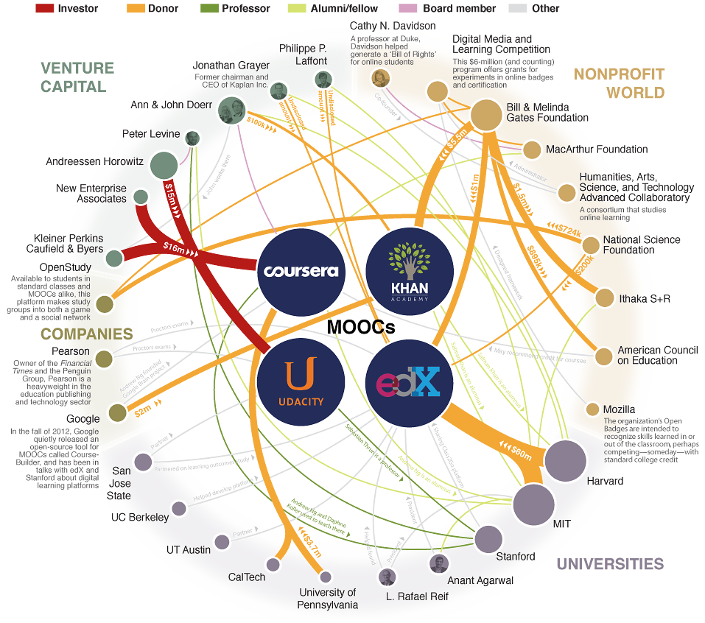
Notes:
Shows the big players in the world of MOOCs

Slide 7
1004.0961 Credit for online courses
Beginning in the 2015-2016 school year, the State Board of Education and the Board of Governors shall adopt rules that enable students to earn academic credit for online courses, including massive open online courses, prior to initial enrollment at a postsecondary institution. The rules of the State Board of Education and rules of the Board of Governors must include procedures for credential evaluation and the award of credit, including, but not limited to, recommendations for credit by the American Council on Education; equivalency and alignment of coursework with appropriate courses; course descriptions; type and amount of credit that may be awarded; and transfer of credit.
MOOC Legislation - HB 7029

Slide 8

Get Ready for College - Math
Notes:
Free to anyone
No instructor or facilitator
Self-paced
Not intended for instruction
Students may be referred as an option for placement test remediation
Students may use as a refresher if they haven’t had math for a few years
Learning certified through successful completion of placement test

Slide 9
Free to anyone
No instructor or facilitator
Self-paced
Not intended for instruction
Students may be referred as an option for placement test remediation
Students may use as a refresher if they have not had math in a few years
Learning certified through successful completion of placement test
Get Ready for College - Math
Notes:
Free to anyone
No instructor or facilitator
Self-paced
Not intended for instruction
Students may be referred as an option for placement test remediation
Students may use as a refresher if they haven’t had math for a few years
Learning certified through successful completion of placement test

Slide 10
October 2012: Idea originated
December 2012: Development team assembled
February 2013: Six-week pilot started (approx. 50 students)
May 2013: May 8th “Go Live” Date
May 2013: Started Read/Write MOOC Development
Development Timeline

Slide 11
Week 1 = 308
Week 2 = 380
Week 3 = 447
Week 4 = 497
Week 5 = 577
Today655
Initial Data

Slide 12

Play Video
Introduction Video in ANGEL

Slide 13
Overall introduction video is inviting and conversational
Brief introduction to each module is encouraging and friendly
All videos recorded by a real St. Petersburg College professor, who gives a face to the instructor-less course.
Pop-up boxes with results of assessment also written in easy, conversational tone
Video scripts and instructions, including terms of use, written for ease of understanding and accessibility (sixth-grade level)
Communication

Slide 14

www.spcollege.edu/ready
Registration Process

Slide 15
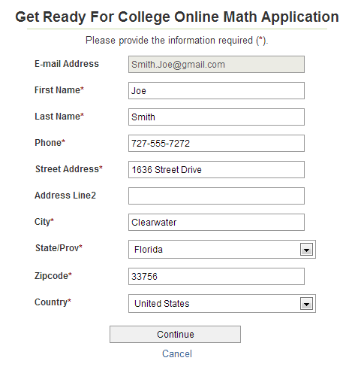
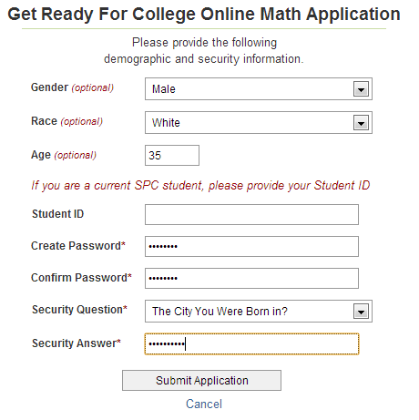
Data Collection
Registration Process

Slide 16
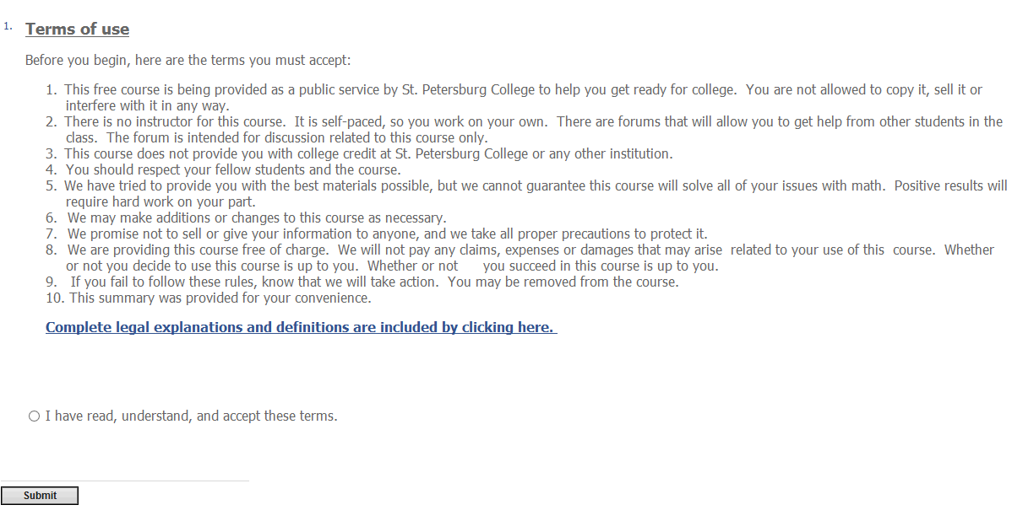
User Agreement
Course Flow- User Agreement

Slide 17
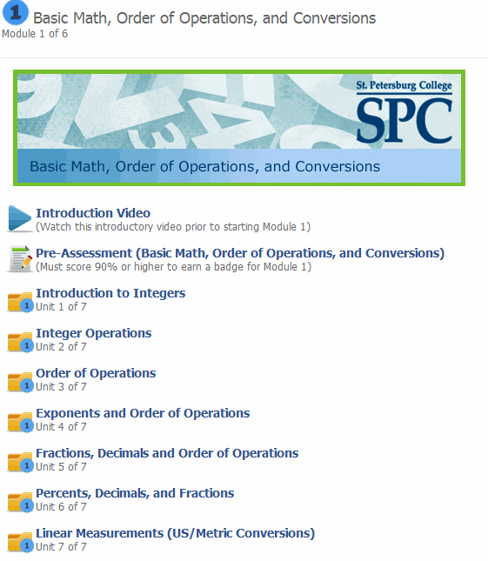
Module Content
Each module has specific unit folders. Students can work on any of the units that they need remediation in, based on their “Pre-Assessment”.
Course Flow- Module Progression

Slide 18
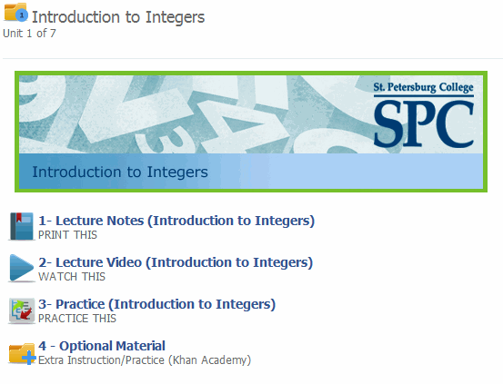
Unit Content
Each unit has printable “Lecture Notes”, a “Lecture Video” reviewing the examples within the notes, randomly-generated “Practice” problems, and “Optional Material” to supplement the unit.
Course Flow- Module Progression

Slide 19
Pre-Assessment
90% or Higher
70% or Higher
70% or Higher
Final Assessment
Post-Assessment
Badge
Certificate
Assessment Model

Slide 20
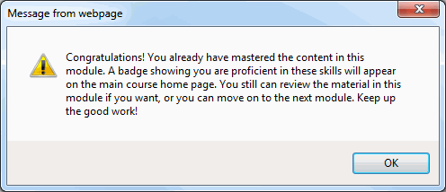
Pre-Assessment
Students begin each module by watching a module introduction video, and taking a 30-question “Pre-Assessment”. If they score a 90% or higher, they receive a competency badge and can proceed to the subsequent module.
Course Flow- Module Progression

Slide 21
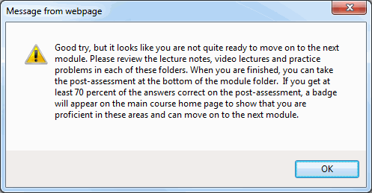
Pre-Assessment
If they score less than a 90%, they are encouraged to work through the units within that module. They can review their “Pre-Assessment” answers, and work on their specific areas of weakness.
Course Flow- Module Progression

Slide 22
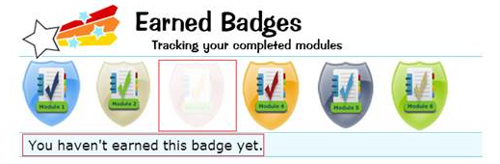
Post-Assessment
Once they are ready, students who had to review the module will take the 30-question “Post-Assessment”. To achieve a competency badge for the module, they must score a 70% or higher on this “Post-Assessment”. They can take it as many times as necessary, with random questions each time.
Students do not need to pass the “Post Assessment” to move on to the subsequent module, although it is strongly encouraged.
Course Flow- Module Progression

Slide 23

Final Assessment
After progressing through the six modules of the course, students will take the 30-question “Final Assessment” to determine competency. To fulfill the remediation requirement, sand receive a printable certificate, students must score a 70% or higher on the “Final Assessment”.
Students can take the “Final Assessment” as many times as they need to, with different questions randomly generated each time.
Course Flow- Module Progression

Slide 24
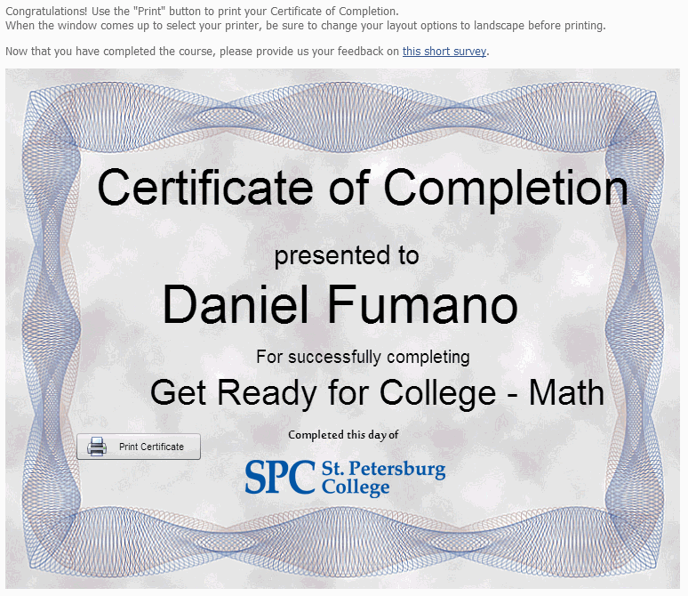
Certificate of Completion
Once they score a 70% or higher on the “Final Assessment”, students are automatically directed to print a “Certificate of Completion” and take a short survey regarding their overall course experience.
Course Flow- Module Progression

Slide 25
Student Survey
After printing the “Certificate of Completion”, or at any point during the course, students can take the “Student Survey” to give us feedback on their overall course experience.
Survey Questions
1. It was easy to navigate through the modules and topics.
2. Lecture notes and lecture videos were easy to understand.
3. Lecture notes and lecture videos prepared me for the practice questions.
4. Practice questions helped me prepare for the end of module assessment.
5. I never felt that I needed an instructor to guide me through the material.
6. The amount of time necessary to complete the course was reasonable.
7. I would recommend this course to others who want to refresh their knowledge of mathematics and algebra.
8. Estimate how many hours you spent on this course.
9. How many modules did you need to complete after taking the pre-assessment?
10. How did you learn about this course?
11. Have you ever taken a college remedial math course?
12. Please select any of the remedial math courses that you have taken. (Select all that apply)
Course Flow- Module Progression

Slide 26
Decisions about model and resources need to be made upfront (facilitated vs. non-facilitated, etc.)
Recognize that interactivity can be expensive
Determine how learning will be ‘certified’
Need to establish a development team which has representation from different areas
Sustainability needs to be addressed
Need strong leadership support
Lessons Learned

Slide 27
Questions

Slide 28


Finish What They Start

