Slide 1
2012-2013 Speech Program
Assessment

Slide 2
2012 – 2013 Valencia College Speech Assessment Program
Objective: To gather a college-wide collection of student oral presentation data from all speech faculty to establish a rubric that can be used for any oral communication discipline.

Slide 3
Assessment Program Process
Purpose of Data Collection:
Meet college-wide Institutional Assessment (Program Learning Outcomes Assessment) goals
Continue providing evidence of student learning

Slide 4
Assessment Program Process
Process for Gathering Data:
Across all 4 campuses
Across all class sections
(in class/ online/ hybrid)
Used heaviest weighted speeches

Slide 5
Assessment Program Process
Criteria measured by rubric:
Organizational Pattern
Central Message
Supporting Materials
Language Choice
Delivery Techniques

Slide 6
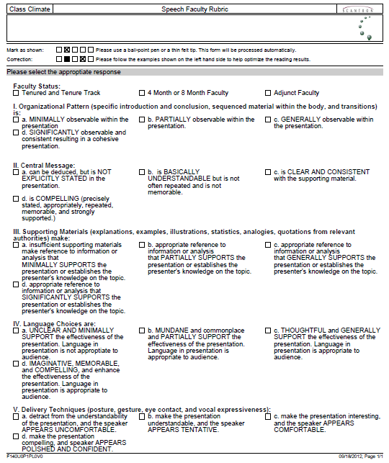
Assessment Program Process

Slide 7
Assessment Program Process
Levels of Accomplishment:

Slide 8
Assessment Program Process
Results Overview:
Approximately 2,500 Scantrons were returned
Approximately 60% faculty response rate

Slide 9
Organizational Pattern
 | Non Adjunct Faculty |  |  | Adjunct Faculty
 | Count | % |  | Count | %
Total | 1294 | 100% |  | 1216 | 100%
No Response | 176 | 13.6% |  | 122 | 10.0%
MINIMALLY | 29 | 2.2% |  | 40 | 3.3%
PARTIALLY | 145 | 11.2% |  | 144 | 11.8%
GENERALLY | 440 | 34.0% | 72.9% | 437 | 35.9% | 74.8%
SIGNIFICANTLY | 504 | 38.9% |  | 473 | 38.9%

Slide 10
Central Message
 | Non Adjunct Faculty |  |  | Adjunct Faculty
 | Count | % |  | Count | %
Total | 1294 | 100% |  | 1216 | 100%
No Response | 153 | 11.8% |  | 88 | 7.2%
NOT EXPLICITLY STATED | 19 | 1.5% |  | 33 | 2.7%
BASICALLY UNDERSTANDABLE | 162 | 12.5% |  | 210 | 17.3%
CLEAR AND CONSISTENT | 531 | 41.0% | 74.20% | 467 | 38.4% | 72.80%
COMPELLING | 429 | 33.2% |  | 418 | 34.4%

Slide 11
Supporting Materials
 | Non Adjunct Faculty |  |  | Adjunct Faculty
 | Count | % |  | Count | %
Total | 1294 | 100% |  | 1216 | 100%
No Response | 143 | 11.1% |  | 86 | 7.1%
MINIMALLY | 68 | 5.3% |  | 108 | 8.9%
PARTIALLY | 300 | 23.2% |  | 209 | 17.3%
GENERALLY | 392 | 30.3% | 60.5% | 395 | 32.5% | 66.9%
SIGNIFICANTLY | 391 | 30.2% |  | 418 | 34.4%

Slide 12
Language Choices
 | Non Adjunct Faculty |  |  | Adjunct Faculty
 | Count | % |  | Count | %
Total | 1294 | 100% |  | 1216 | 100%
No Response | 127 | 9.8% |  | 75 | 6.2%
MINIMALLY | 20 | 1.5% |  | 22 | 1.8%
PARTIALLY | 184 | 14.2% |  | 214 | 17.6%
GENERALLY | 624 | 48.2% | 74.4% | 548 | 45.1% | 74.5%
SIGNIFICANTLY | 339 | 26.2% |  | 357 | 29.4%

Slide 13
Delivery Techniques
 | Non Adjunct Faculty |  |  | Adjunct Faculty
 | Count | % |  | Count | %
Total | 1294 | 100% |  | 1216 | 100%
No Response | 122 | 9.4% |  | 75 | 6.5%
UNCOMFORTABLE | 78 | 6.0% |  | 22 | 3.8%
TENTATIVE | 271 | 20.9% |  | 214 | 21.6%
COMFORTABLE | 497 | 38.4% | 63.6% | 548 | 42.7% | 68.1%
POLISHED AND CONFIDENT | 326 | 25.2% |  | 357 | 25.4%

Slide 14
Summary (Level 3 or Higher)
Organizational Pattern | 73.90%
Central Message | 73.50%
Supporting Materials | 63.70%
Language Choices | 74.50%
Delivery Techniques | 65.90%

Slide 15
Assessment Outcomes & Next Steps
Outcomes:
Speech rubric established for cross-discipline use
Affirms speech faculty assessment leveling
Next Steps:
Create supporting materials intervention tool to improve student learning
Assess student use of supporting materials in heaviest weighted speech

