Slide 1

A Model for Assessing General Education Utilizing an Online Institutional Assessment
Student success is the first priority
2013 State Assessment Meeting

Slide 2
General Education Assessment Model
Presenters
Maggie Tymms, Assessment Director
Ashley Caron, Baccalaureate Assessment & Accreditation Coordinator
Academic Effectiveness & Assessment
St. Petersburg College

Slide 3
St. Petersburg College Quick Facts
SPC, established in 1927, is the oldest 2-year college in Florida
First FCS college to offer baccalaureate degrees (2002); 1,168 (2011-12)
9 Campuses throughout Pinellas County
2012-13 FTE: 21,546
2012-13 Graduates: 6,149
Fall 2012 credit enrollment: 33,232
(unduplicated)

Slide 4
Today’s Goals
Define the primary objectives of assessing general education
Provide the history of SPC’s prior assessment model
Examine the purpose and development of the new process
Review instrument specifications, implementation
Highlight the results and advantages of the new model
Discuss the next steps of the process
Consider the lessons learned

Slide 5
Primary Objectives
The primary objectives of the assessment are:
Evaluate the quality of the general education curriculum
Identify areas for performance improvement
Satisfy the college’s commitment to the Southern Association of Colleges and Schools (SACS)

Slide 6
Primary Objectives: SACS
SACS Comprehensive Standard 3.5.1
  The institution identifies college-level general education competencies and the extent to which students have attained them. (General education competencies)
Other related Standards: Core Requirement 2.5 and Comprehensive Standard 3.3.1
Notes:
Note for #2: SPC collects and stores thousands of data elements at the institution, yet it has various polices, procedures, and software related mechanisms in place that restrict (or even at times prevent) the use and access of data.

Slide 7
History: Focus of the assessment
SPC’s General Education assessments focus on the general learning outcomes of all degree programs across the college.
Three-year cycle
Mostly course-based
Direct and indirect measures
Some standardized measures

Slide 8
History: Prior Assessment Model
Primarily course-based: Possible that knowledge level of traditional graduate would not be reflected
Discipline-specific assessments: Consisted of a minimal number of imbedded items, not consistent across classes
Data collection: Difficult, often incomplete
Items developed in isolation, lacked sufficient review
Results not consistently meaningful for continuous improvement

Slide 9
Purpose of the new model
‘Psychometrically sound’ assessment model
Maximize benefits of new data collection model – continuous improvement of general education curriculum
Utilization of available technology
Notes:
Establish a ‘psychometrically sound’ General Education assessment model to assess students nearing the completion of their degree
Utilize the results produced by this new assessment model to identify specific areas of SPC’s general education curriculum for continuous performance improvement
Utilize available technology in order to encourage student participation through a cost-effective online administration model that allows data to move seamlessly among systems

Slide 10
Purpose:
Performance Improvement
From Compliance to Performance Improvement

Slide 11
Assessment Development:
General Education Outcomes
Critical Thinking
Analyze, synthesize, reflect upon, and apply information to solve problems, and make decisions logically, ethically, and creatively
Communication
Listen, speak, read, and write effectively
Scientific and Quantitative Reasoning
Understand and apply mathematical and scientific principles and methods
Information and Technology Fluency
Find, evaluate, organize, and use information using a variety of current technologies and other resources
Global Socio-Cultural Responsibility
Participate actively as informed and ethically responsible citizens in social, cultural, global, and environmental matters
Notes:
Originally had 11 outcomes, which were antiquated and not all were measurable. For instance, Life Long Learning – unable to measure demonstration of this goal prior to program completion. SPC based the new outcomes on the State general education goals.

Slide 12
Test Specifications:
Item Content
Each form consists of fifty multiple-choice items comprised of content from the five general education outcomes:
Critical Thinking: 6 items
Communications: 11 items
Scientific and Quantitative Reasoning: 11 items
Information and Technology Fluency: 11 items
Global and Socio-Cultural Responsibility: 11 items
Discipline-specific items are developed by the General Education Deans and their faculty

Slide 13
Test Specifications:
Item Development Process
Operationalize the goal (list domains)
Determine # of items (domains)
Determine # and types of items for each domain
Identify competencies for each domain
Determine # and types of items for each competency
Using item writing sheets, ‘code’ existing items or create new items to align with Goals, Domains, and Competencies listed in the Test Specification Sheet

Slide 14
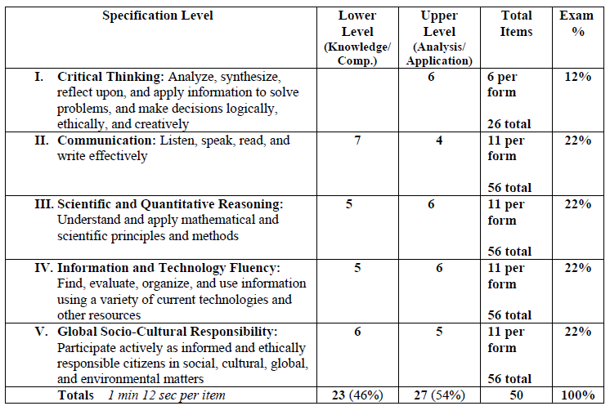
Test Specifications
Notes:
Point out the quick access for end-users

Slide 15
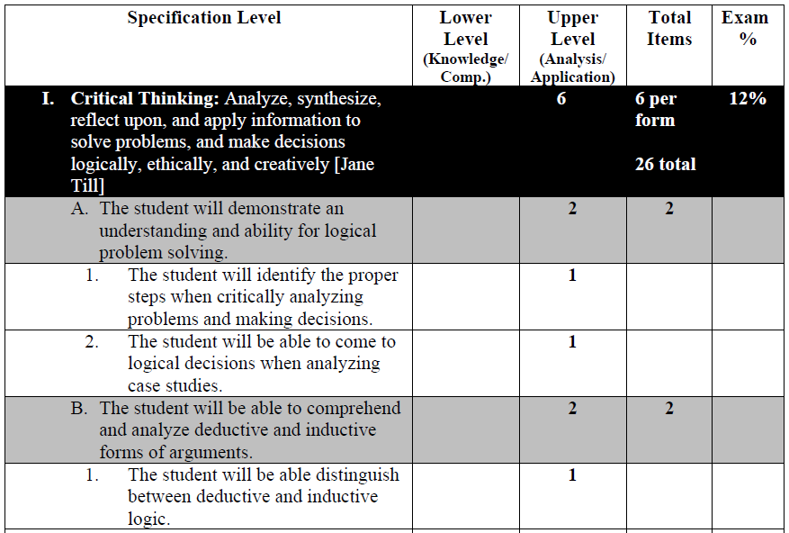
Test Specifications
Notes:
Point out the quick access for end-users

Slide 16
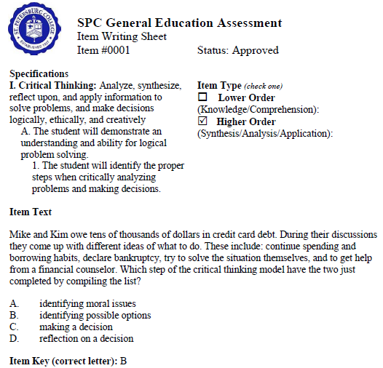
Test Specifications:
Item Writing Sheet
Notes:
Although specs haven’t changed, new items have continued to be added for each competency as new forms have been added. Deans work with faculty members to create the items.

Slide 17
Assessment Implementation
Student Selection Process:
  Enrolled at least once in last three semesters
  Completed 45-55 credit hours of course work
  Have not previously taken the assessment
Eligible students are then uploaded into SPC’s learning management system, ANGEL
Senior VP invites selected students to participate via a personal e-mail (e-mail merge)
Gen Ed Test appears as a course in ANGEL
Notes:
The Gen Ed test is activated immediately prior to the e-mail invitation being sent out.

Slide 18
Assessment Implementation:
Invitation Letter
Congratulations! You have successfully completed 45 or more credit hours including St. Petersburg College and transfer credits, and have been selected to participate in the General Education Assessment.
The purpose of this General Education Assessment is to evaluate the quality of our general education curriculum and identify areas for performance improvement. Your results and those of fellow classmates will assist us in improving the general education courses and ensuring that we will meet the needs of current and future students.
To complete the assessment, go to your course list in ANGEL. A new course link has been added to your list of courses. It is entitled 420 General Education Outcomes Assessment. Within that course link is a single assessment entitled, General Education Outcomes Assessment. Please complete this assessment before April 4th.
Upon accessing the assessment, you may receive a ‘Security Warning’ message asking if you want to view only the webpage content that was delivered securely. Please note that the correct response to the Security Warning message is to select ‘NO’.
You may use a calculator, and we suggest that you have scratch paper available when taking the assessment. On average the assessment takes about forty minutes to complete. You will be given a ninety-minute time limit to complete the assessment. The ninety minute time limit starts when you select ‘Begin Assessment’, so it must be completed in one sitting.
If you have any questions regarding this assessment, please contact the department of Academic Effectiveness and Assessment at 727.341.3177, or Sanchez.Angelica@spcollege.edu.
Thank you in advance for your participation in this critically important college endeavor.
Anne M. Cooper, Ph.D.
Senior Vice President, Academic and Student Affairs
Notes:
Students will see that a deadline is given in the invitation, which is typically about one month prior to the end of the term. The day after the deadline, another message is sent to all students who have not yet responded that the test has been extended until one week prior to final exams.

Slide 19
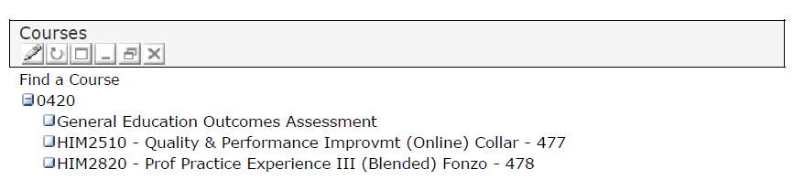
Assessment Implementation:
ANGEL
ANGEL Course list

Slide 20
Assessment Implementation:
ANGEL
Notes:
After clicking the Gen Ed test in their course list, this screen appears. In this case, the student sees form 2010-1. Although all utilized forms have been uploaded into Angel, students only see the one that they are assigned to.

Slide 21
Assessment Implementation:
Frequently Asked Questions (FAQ)
Frequently Asked Questions (FAQs)
General Education Outcomes Assessment
1. Why has this course been added to my ANGEL page?
This course is listed on your ANGEL page because you have been selected to participate in the General Educational Assessment due to your successful completion of 45 or more credit hours of combined SPC and transfer credits.
2. What is the purpose of this assessment?
The purpose of the General Education Assessment is to evaluate the quality of our general education curriculum. The aggregate results of this assessment will assist in improving our general education courses, as part of the College’s commitment to continuous improvement.
The assessment also satisfies our obligation to the Southern Association of Colleges and Schools (SACS), our
accrediting entity which ensures the high quality of the degree you will receive upon graduation.
3. Why do I have to take the assessment if a portion of my total credits are transfer credits?
Students who have completed a total of 45 credits including SPC and transfer credits were selected. Your results and those of other SPC students will assist us in improving the general education courses and ensuring that we meet the needs of our students.
Notes:
13 total FAQs available to students. These were created early on in the process, which were the most frequently occurring. The most frequent question is about whether the assessment is required. While it is not, we are working with deans and senior leadership to determine if it would be possible to require the test before graduation.

Slide 22
Assessment Implementation:
Frequently Asked Questions (FAQ)
4. Why do I have to take the assessment if I am pursuing a degree in a specific discipline?
As per our agreement with our accreditation body, the Southern Association of Colleges and Schools, students across all disciplines are required to take a specified number of general education courses as part of their degree requirement. As a result, all students, regardless of discipline, who have completed 45 credits were selected to participate in the General Educational Assessment. Your results and those of other SPC students will assist us in improving the general education courses and ensuring that we meet the needs of our students.
5. What is the deadline for completing this assessment?
The assessment will be available on your ANGEL course until one week before the end of the current term.
6. How long does it take to complete the assessment?
On average the assessment takes about 40 minutes to complete. You will be given a ninety-minute time limit.
7. May I use a calculator?
You may use a calculator, and we suggest that you have scratch paper available when taking the assessment.
8. I opened the assessment but closed it without completing it. May I complete the assessment at a later time?
Yes, you may access and complete the assessment at a later time as long as you do not select ‘Begin Assessment’. Once you select the option to begin the assessment you must complete and submit it within ninety minutes.
Notes:
13 total FAQs available to students. These were created early on in the process, which were the most frequently occurring. The most frequent question is about whether the assessment is required. While it is not, we are working with deans and senior leadership to determine if it would be possible to require the test before graduation.

Slide 23
Assessment Implementation:
Frequently Asked Questions (FAQ)
9. How do I know if I passed the assessment?
The score you receive on the assessment is a percentage of your correct responses, however there is no pass or fail associated with the score. The results of the assessment are only used to assist us in improving the general education courses.
10. Why am I unable to listen to the audio file needed to answer the related item(s) in the assessment?
This issue may be the result of an older version of the Flash Player installed on your computer. Older Flash Player versions may have a compatibility issue with the current version of ANGEL that we are using at the College. If you are taking the assessment and have the issue, you may ignore that item(s) on the assessment.
11. How should I respond to the ‘Security Warning’ message: ‘Do you want to view only the webpage content that was delivered securely?'
The correct response to the Security Warning message is to select 'NO'.
12. Will the results of this assessment affect my grades?
The results of this assessment will remain confidential, and will not affect your course grades or overall grade point average. Your results will be combined with those of other SPC students to assist us in improving the general education curriculum.
13. Who should I contact with additional questions?
If you have any additional questions regarding this assessment, please contact the department of Academic Effectiveness and Assessment at 727.341.3177, or Sanchez.Angelica@spcollege.edu.
Notes:
13 total FAQs available to students. These were created early on in the process, which were the most frequently occurring. The most frequent question is about whether the assessment is required. While it is not, we are working with deans and senior leadership to determine if it would be possible to require the test before graduation.

Slide 24
Assessment Implementation:
Is this assessment required?
The purpose of the General Education Assessment is to evaluate the quality of our general education curriculum. The results of this assessment will assist in improving our general education courses, as part of the Colleges’ commitment to continuous improvement.
In addition to using the aggregate assessment results for quality improvement proposes, the assessment also satisfies our obligation to the Southern Association of Colleges and Schools (SACS). This is extremely important for the institution and for our students. For without accreditation, the diploma that you will receive when you graduate would not be as meaningful for future pursuits.
The results of this assessment will remain confidential, and will not affect your course grades or overall grade point average. Your results will be combined with those of other SPC students to assist us in improving the general education curriculum.
Although completion of this assessment is not a graduation requirement, it is of great importance to SPC and to our students.
Notes:
13 total FAQs available to students. These were created early on in the process, which were the most frequently occurring. The most frequent question is about whether the assessment is required. While it is not, we are working with deans and senior leadership to determine if it would be possible to require the test before graduation. One major benefit of the FAQs is that having this available standardizes responses to students from the institution.

Slide 25
Assessment Implementation:
Spring 2010 – Spring 2013
Piloted in Spring and Summer 2010 using a single form (#1)
Fall 2010 pilot included three different forms (#1-3)
Same three forms administered Spring and Summer 2011
Fall 2011, Spring 2012 administered the fourth form (#2-4), ETS
Summer and Fall 2012 included same forms
  Developed and will be piloting form 5 in Spring 2013 (#2-5)
  Will continue to administer assessment each semester
  Scores are transferred from ANGEL to PeopleSoft (student information system)
Notes:
Since form 1 had been used several semesters, in fall 2011 and spring 2012 we used forms 2, 3, and 4, as well as the ETS Proficiency Profile. Transferring scores to PS assists in future administrations, so students who have test scores in their records are not pulled on the following term’s list of eligible students.

Slide 26
Assessment Implementation:
Student Contacts & Response Rates
Multiple Student Contacts
  Personal student reminders to non-respondents throughout term
  One student reminder via paper mail
  Scripts used to respond promptly to student inquiries
  Spring 2012 Response Rates per student contact
Spring 2012 | Date | Number Sent | Number Submitted | % Received | % Submitted Overall
1st E-mail merge | 2/2/2012 | 2218 | 73 | 3.4% | 3.3%
2nd E-mail | 2/13/2012 | 2155 | 35 | 1.7% | 1.6%
3rd E-mail | 2/28/2012 | 2108 | 45 | 2.2% | 2.0%
1st Mailing | 3/20/2012 | 1535 | 35 | 2.3% | 1.6%
4th E-mail | 4/1/2012 | 1499 | 134 | 9.3% | 6.0%
5th E-mail | 4/20/2012 | 1367 | 54 | 4.1% | 2.4%
Totals |  | 10882 | 376 |  | 17.0%
Total Students | 2218
Notes:
Average response rates have been 17% to 22%.

Slide 27
Assessment Implementation:
Response Rates by Term
Term | Total Students | Number Sent | Number Submitted | % Submitted Overall
Spring 2011 | 2171 | 11893 | 483 | 22%
Summer 2011 | 1361 | 4907 | 285 | 21%
Fall 2011 | 1941 | 9247 | 324 | 17%
Spring 2012 | 2218 | 10882 | 376 | 17%

Slide 28
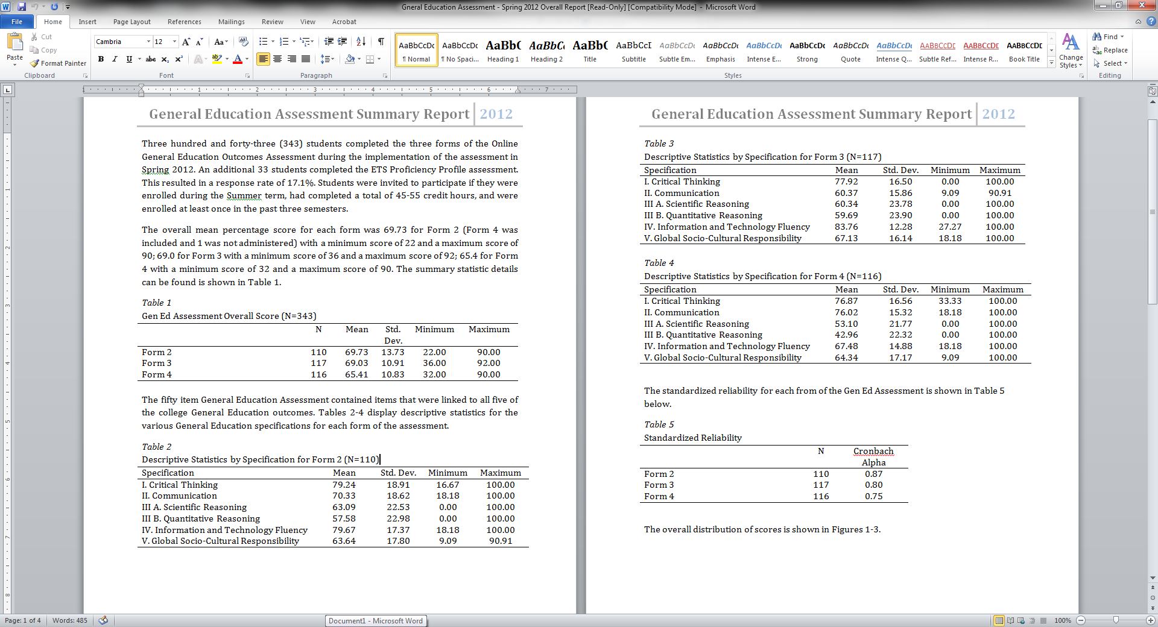
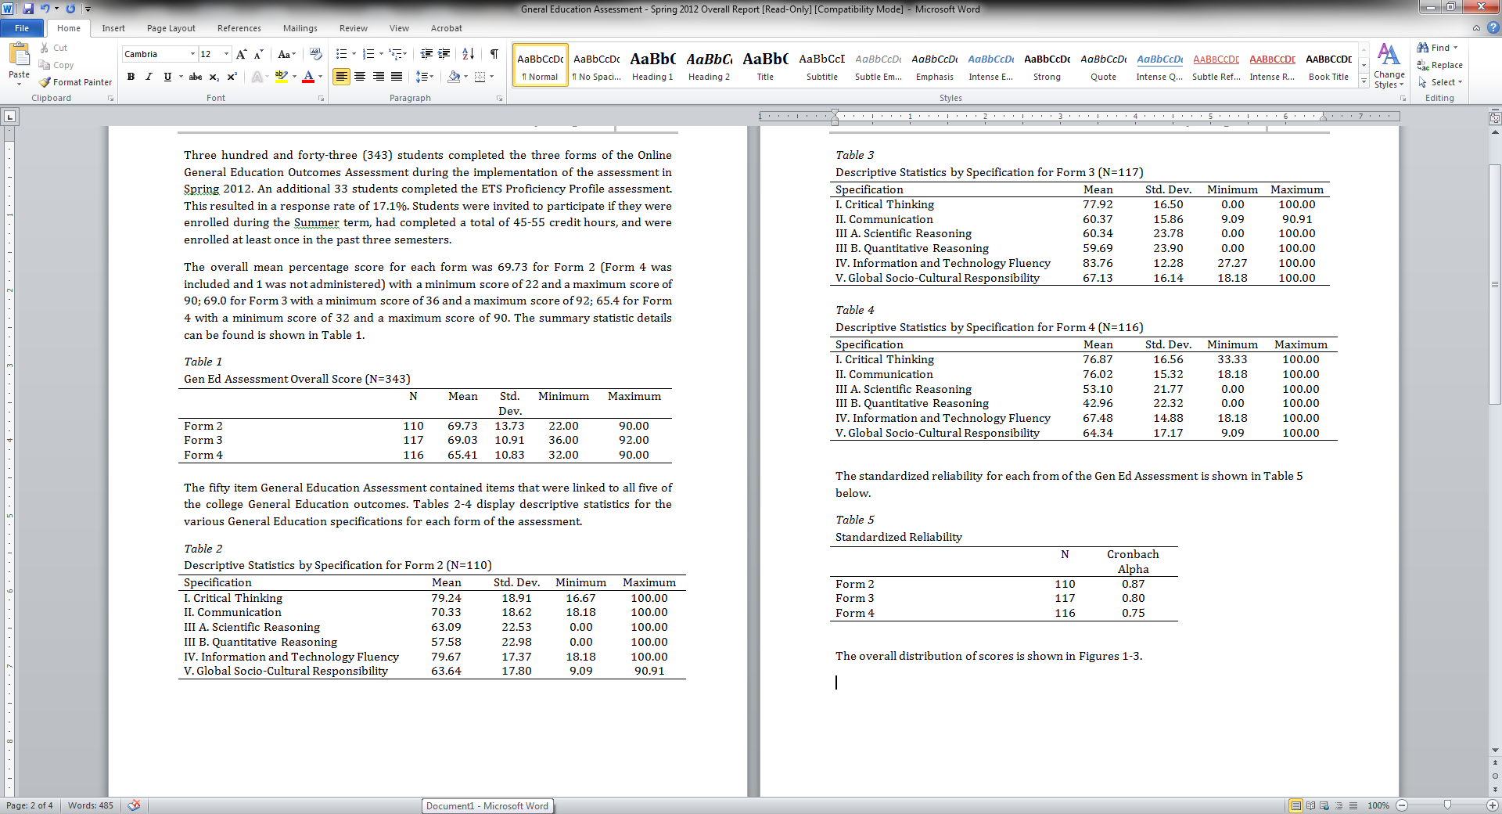
Assessment Results:
Spring 2012

Slide 29
Assessment Results:
Spring 2012

Slide 30
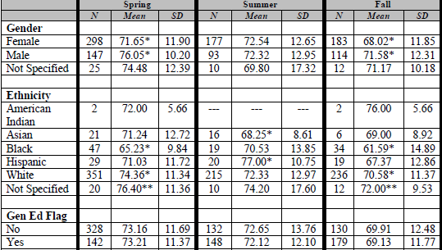
Assessment Results:
Demographics
  Sample Assessment Results

Slide 31
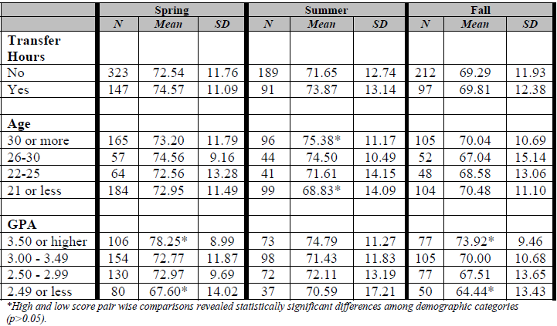
Assessment Results:
Demographics, cont’d
  Sample Assessment Results

Slide 32
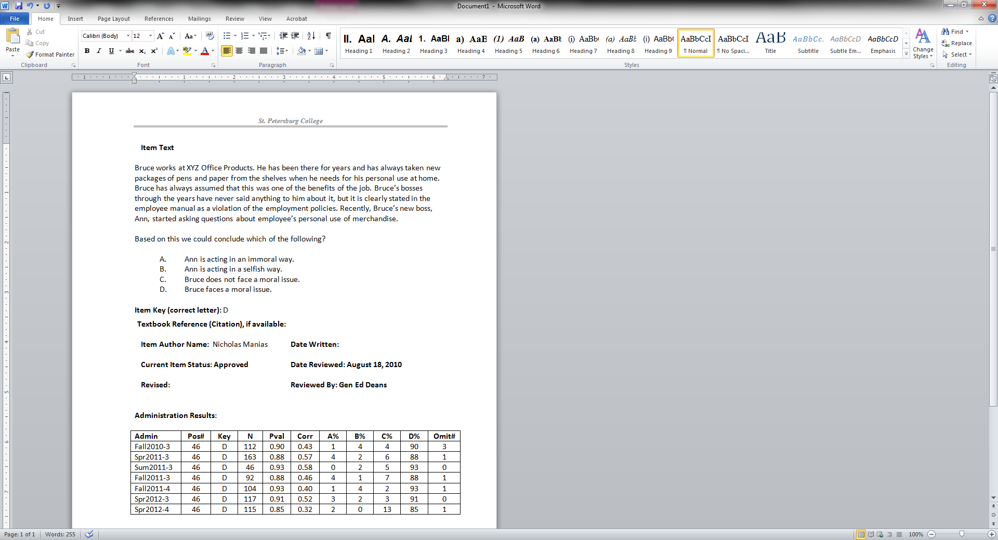
Assessment Results:
Breakdown by item, term, and form

Slide 33
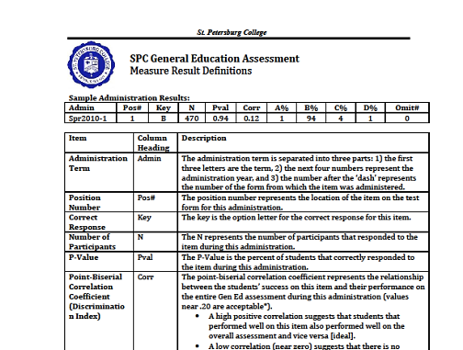
Assessment Results:
Measure Descriptions

Slide 34
Assessment Results:
Findings from recent administration
Areas of weakness identified
  Inference, fact/opinion, bias, and relationships within sentences
Data shared with Communications Dean
Communications Faculty created action plan to improve student learning outcomes
Actions: Curriculum Revisions
Require pre-requisite or co-requisite for ENC1101
  Provides scaffolding to promote student success
Compose a course of record for ENC1101 to reinforce
  Basic grammar skills
  Complex grammatical structures
  Parallel expressions
  Active and passive voice

Slide 35
Advantages of New Assessment
Institutional-based as opposed to classroom-based
More representative results from students who have completed the majority of Gen Ed and other courses
Results are generalizable to SPC population
Potential for higher participant rate
Removes impact on classroom time

Slide 36
Lessons Learned
Faculty involvement is crucial
Requires academic structure, such as Gen Ed Deans, to be successful
Need psychometric resources
Senior leadership endorsement and support is vital
Technology infrastructure is necessary
Requires adequate staff and resources

Slide 37
Next Steps
Continue to administer all five forms of the Institutional Assessment for the remainder of 2013
Analyze the results of pilot forms 1, 2, 3, 4, and 5
Using the analysis results, develop four equal forms in terms of item difficulty
Continue to analyze all forms to determine validity and reliability
Work with the General Education Assessment subcommittee to develop a proposed timeline for SPC to implement a plan in which the Institutional Assessment would be mandatory for all students before graduation, and research the requisites and procedures required to place the Gen Ed score on student transcripts
Begin widely disseminating assessment results:
  Academic Effectiveness site (http://www.spcollege.edu/central/ae/)
  Center of Excellence for Teaching and Learning site (http://www.spcollege.edu/cetl/)
Notes:
Once we have sufficient data on form 5, analysis will be done to also include a fifth form of equal difficulty to the first four forms. Also would like to make results available to students

Slide 38
Questions?

Slide 39
Institutional Online
General Education Assessment Model
Presenters
Maggie Tymms, Associate Director
Tymms.magaly@spcollege.edu
Ashley Caron, Baccalaureate Assessment & Accreditation Coordinator
Caron.ashley@spcollege.edu
Academic Effectiveness & Assessment
St. Petersburg College

