Slide 1

Principles of Good Practice in Research at Valencia College
Tuesday, February 24, 2:00 – 3:00, EC 4-122 (CRN2966)
Laura Blasi, Ph.D., Director, Institutional Assessment
  What steps can I take to assure the quality of my research?
  What steps should I take to respect and protect the rights of participants?
  Key questions to determine –“What kind of research am I proposing?”
  What is the IRB?
  Does it need review by the Valencia Institutional Review Board (IRB)?

Slide 2
SOTL 3271: IRB Requirements and Your Research
This course will provide an overview of the Principles of Good Practice and within that the role of the Institutional Review Board (IRB) for all faculty members who are planning to conduct research studies at Valencia College.

Slide 3
Outcomes
At the end of this session you will be able to…
…discuss the principles of good practice for research.
…describe the role of the IRB.
…define your own research study and apply the IRB checklist to determine if it is exempt from review.
Define the NIH training and complete it for certification.

Slide 4
Introductions
Who will be your research participants?
What will you tell them when you describe your study?

Slide 5
Curious about implementation?
Will the implementation of an intervention tool improve the retention rate of students in online speech? Liza Schellpfeffer (speech)
Implement a personal response system, an interactive learning technique, to improve student engagement and test scores on related material. Julie Wince (nursing)
  RQ #1: Will using personal response devices during lectures improve student engagement?
  RQ #2: Will using personal response devices during lectures improve student’s test scores on related material?

Slide 6
Even Before Implementation
How Can Research Help?
I plan to document the impact of a new teaching method that I plan to implement…
What would I need to know about my students / my class to help me to implement the work?
What sort of studies would help me prior to an implementation study?

Slide 7
Scholarship of Teaching and Learning (SoTL)
The Scholarship of Discovery
The Scholarship of Integration
The Scholarship of Application
The Scholarship of Teaching

Slide 8
What is “…the scholarly”
When it entails, as well, certain practices of classroom assessment and evidence gathering, when it is informed not only by the latest ideas in the field but by current ideas about teaching the field, when it invites peer collaboration and review, then that teaching might rightly be called scholarly, or reflective, or informed. (Hutchings & Shulman, 1999).

Slide 9
Problem?
In scholarship and research, having a problem is at the heart of the investigative process; it is the compound of the generative questions around which all creative and productive activity revolves.
But in one's teaching, a "problem" is something you don't want to have, and if you have one, you probably want to fix it.
Changing the status of the problem in teaching from terminal remediation to ongoing investigation is precisely what the movement for a scholarship of teaching is all about (Bass, 1998, cited in Hutchings and Shulman, 1999).

Slide 10
Scholarship Assessed (1997)
All works of scholarship (discovery, integration, application, or teaching) involve a common sequence of six unfolding stages.
  Clear goals
  Adequate preparation
  Appropriate methods
  Significant results
  Effective communication
  Reflective critique
(Drawn from results from 865 survey respondents, Glassick, 1997.)

Slide 11
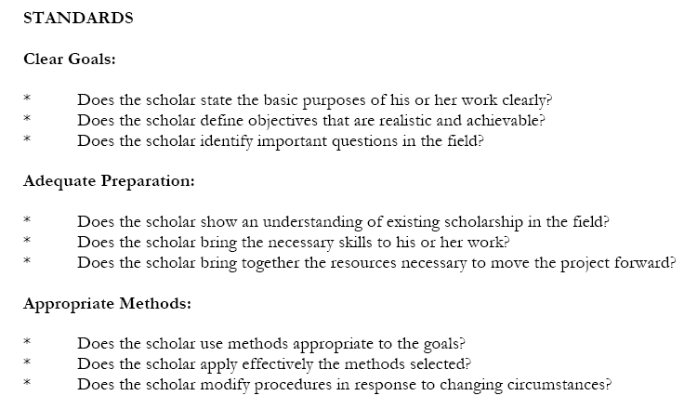

Slide 12
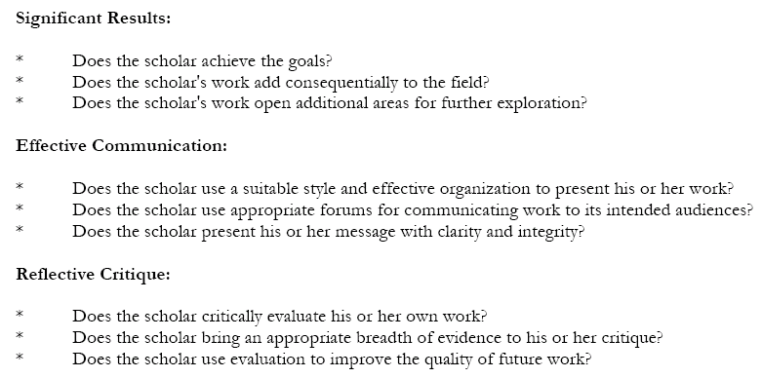

Slide 13
Instrumental
One of the things we have observed thus far is that many faculty gravitate to questions that might be described as "instrumental": Does this new method I'm trying lead to more or better learning than the traditional one?
Such questions are eminently sensible, the very ones, we suspect, for which there is a real audience on campuses, where faculty (and their deans) want to know whether a given approach is likely to be more powerful than another and whether it is therefore worth the time and resources to make the change.

Slide 14
Conceptual
But the scholarship of teaching can also make a place for "what" questions—questions in which the task is not to "prove" but to describe and understand an important phenomenon more fully:
What does it look like when a student begins to think with a concept rather than simply about it?
How can we describe the character of learning in a service-learning site? There must be a place, too, for questions that allow for more theory-building forms of inquiry, and for the development of new conceptual frameworks.

Slide 15
What are
Principles of Good Practice?
Principles of
Good Practice
Federal
Regulations:
Institutional
Research Board (IRB)
Research at
Valencia College

Slide 16
A Few of the Principles…
Do No Harm
Give Back to Your Participants
You need to decide your research purpose and questions – whether qualitative and/or quantitative approaches will help you to answer the questions. What are the principles of good research design? How does this relate to your practice as a researcher?
See: Creswell, J. W. (2009). Research design: Qualitative, quantitative, and mixed methods approaches (3rd ed.). Los Angeles, CA: SAGE Publications, Inc.

Slide 17
Examples of Good Practice: Surveys
Explain your purpose
Let participants know that they can stop at any time
Note the ways it will be confidential or anonymous
Test out your survey before launching it
Connect your work to research already done in the field
In your introduction mention how long the survey will take
Include a “thank you” at the end
Consider following up with results or in some other way
See: Dillman, D. A. (1999). Mail and internet surveys:
The tailored design method. (2nd ed.), New York, NY: John Wiley & Sons.

Slide 18
IRB Review: Valencia
Key Questions Screening Form
This form has several questions that we use to document your study title, topic, and methods as well as the kind of research that you are conducting.
The Key Questions form will help you to determine whether or not you need to submit your research proposal for IRB review.
The federal government requires review of certain kinds of research by an Institutional Review Board (IRB) at our College to protect participants from risk and researchers, also.
Does yours need to be reviewed?
9/18/2012

Slide 19
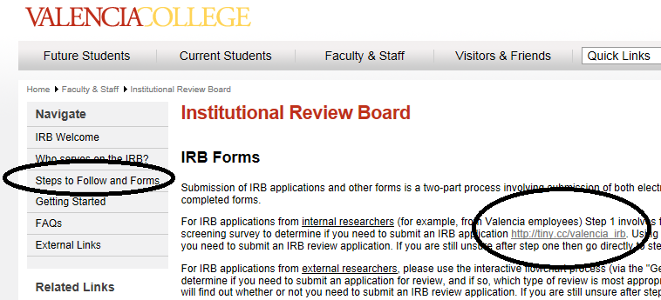
Here is the link….
http://www.valenciacollege.edu/irb

Slide 20
Caveats….
Dissertations
Masters
Federal Grants
Other…

Slide 21
IRB Contact
Laura Blasi, Director,
Institutional Assessment
lblasi@valenciacollege.edu

Slide 22
Checklist
If you complete the checklist and need to complete the IRB review forms, more detailed training is available which covers the history that has led to the creation of the IRB and informed consent.

Slide 23
Key Milestones in the History of IRB Development
1947 The Nuremberg Code standards by which to judge the human experimentation conducted by the Nazis.
1964 Recommendations guiding medical doctors in biomedical research involving human subjects
1974 Protection of human subjects in research supported or conducted by HHS (then the Department of Health, Education and Welfare) a series of highly publicized abuses in research led to the enactment of the 1974 National Research Act which created the National Commission for the Protection of Human Subjects of Biomedical and Behavioral Research (National Commission).
9/18/2012

Slide 24
In 1979, the National Commission published ‘Ethical Principles and Guidelines for the Protection of Human Subjects of Research,’ also known as the Belmont Report (http://www.hhs.gov/ohrp/ policy/belmont.html) which identified three fundamental ethical principles for all human subjects research—respect for persons, beneficence, and justice.
The HHS regulations are codified at 45 CFR part 46, subparts A through E. In 1991, 14 other Federal departments and agencies joined HHS in adopting a uniform set of rules for the protection of human subjects, the ‘‘Common Rule,’ identical to subpart A of 45 CFR part 46 of the HHS regulations.
10/3/2013

Slide 25
The Common Rule
The Common Rule requires that federally funded investigators in most instances obtain and document the informed consent of research subjects, and describes requirements for institutional review board (IRB) membership, function, operations, research review, and recordkeeping. The regulations also delineate criteria for, and levels of, IRB review.

Slide 26
Which Questions Remain?
Principles of
Good Practice
Federal
Regulations:
Institutional
Research Board (IRB)
Research at
Valencia College

Slide 27
Read the Regulations that Were Used to Create the Checklist
45 Code of Federal Regulations Part 46
Protection of Human Subjects
45 CFR §46.101 Paragraph B
http://www.hhs.gov/ohrp/policy/ohrpregulations.pdf
http://www.hhs.gov/ohrp/policy/ohrpregulations.pdf
Read more about how research is defined….

Slide 28
Principles of Good Practice in Research at Valencia College
  What steps can I take to assure the quality of my research?
  What steps should I take to respect and protect the rights of participants?
  Key questions to determine –“What kind of research am I proposing?”
  What is the IRB?
  Does it need review by the Valencia Institutional Review Board (IRB)?

Slide 29
Boyer, E. (1990). Scholarship reconsidered: Priorities of the professoriate. San Francisco, CA: Jossey-Bass.
Glassick, C. E., Huber, M. T., & Maeroff, G. I. (1997). Scholarship assessed: Evaluation of the professoriate. San Francisco, CA: Jossey-Bass.
Hutchings, P., & Shulman, L. S. (1999). The scholarship of teaching: New elaborations, new developments. Change, 31(5), 10-15.
For more readings: http://www.sotl.ilstu.edu/resLinks/selBibl.shtml

