Slide 1
Ucf-VC campus bookstore
Dual enrollment student ordering guide

Slide 2
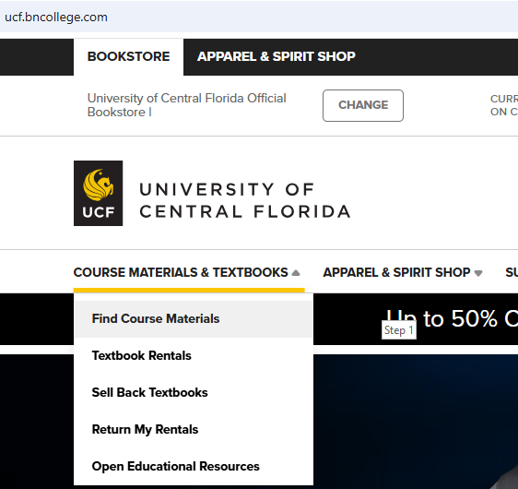
Step 1
STEP 1: VISIT OUR WEBSITE
ucf.BNCOLLEGE.COM AND CLICK
COURSE MATERIALS & TEXTBOOKS,
AND THEN CLICK FIND COURSE materials

Slide 3
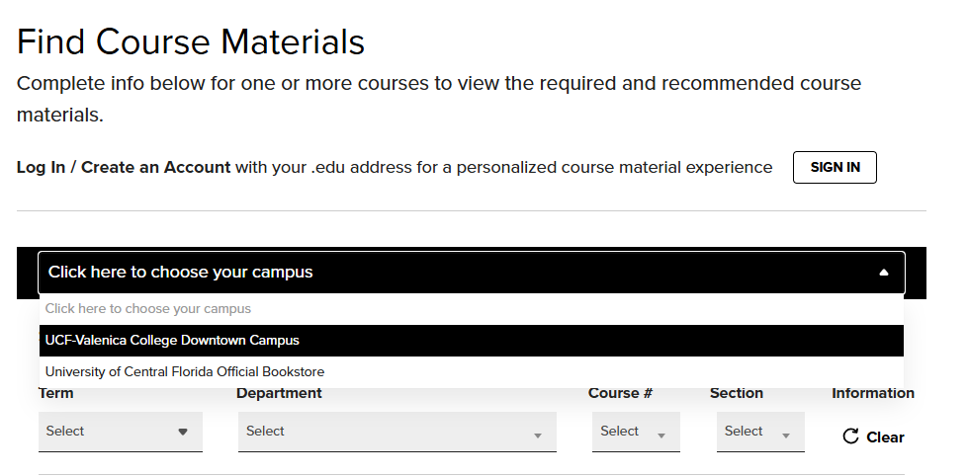
Step 2
Select the UCF-Valencia college downtown campus

Slide 4
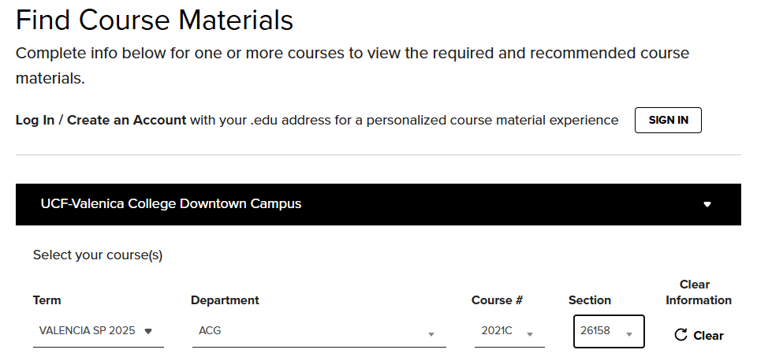
STEP 3
ENTER COURSE INFORMATION FOR INDIVIDUAL FOR THE CURRENT TERM.

Slide 5
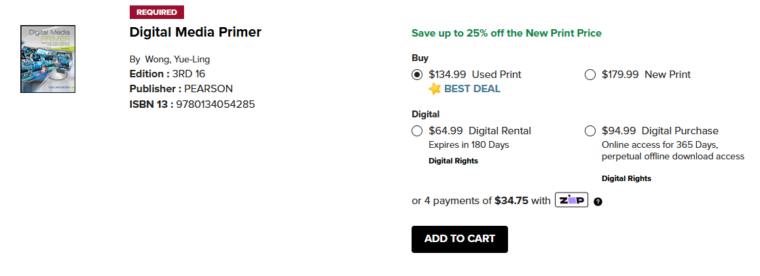
STEP 4
All course materials will generate
Select the preferred format of new, used, or digital
Do not select rent
ADD ALL REQUIRED ITEMS TO CART TO CONTINUE
NOTE: WE WILL FULFILL WHATEVER CONDITION IS ACTUALLY IN STOCK (EXAMPLE, IF YOU ORDER NEW AND WE ONLY HAVE USED, WE WILL FULFILL USED).

Slide 6
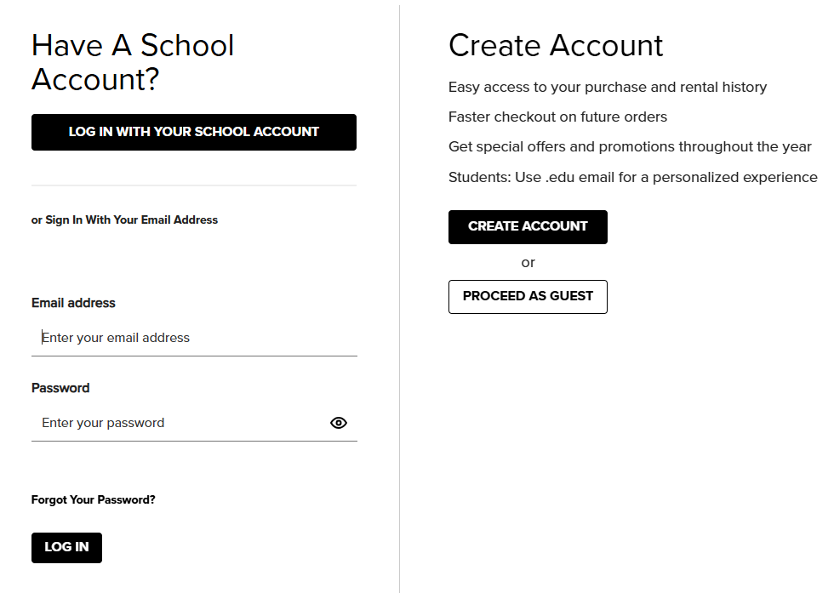
Step 5
Create an account or sign in
Will automatically direct to this page once you click checkout and approve book condition notice
Create an account if you do not already have one- USE YOUR VALENCIA Student EMAIL ONLY
DO NOT click log in with school account it does not auto connect to your school

Slide 7
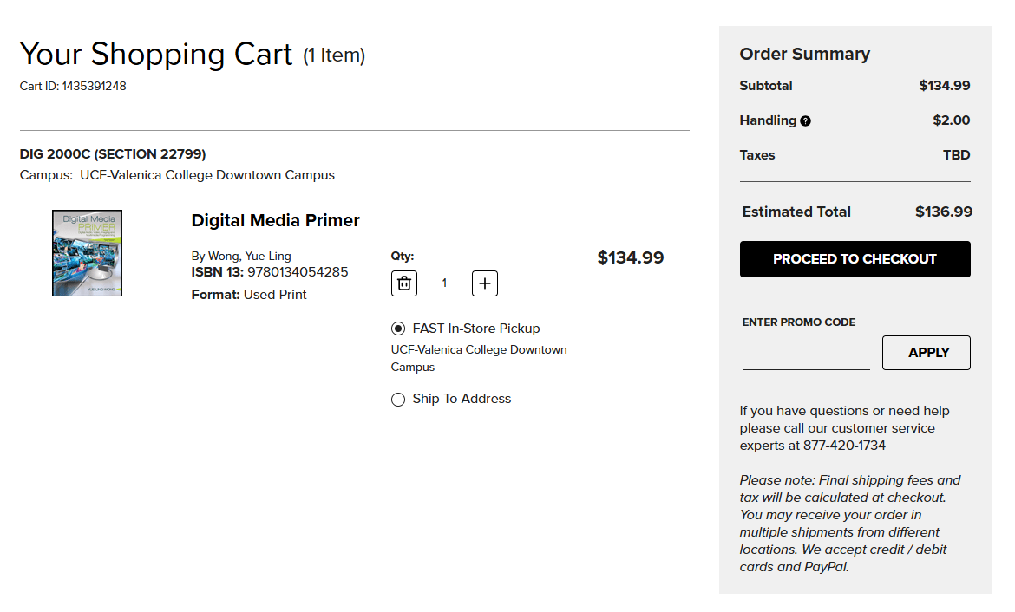
Step 6
Checkout

Slide 8
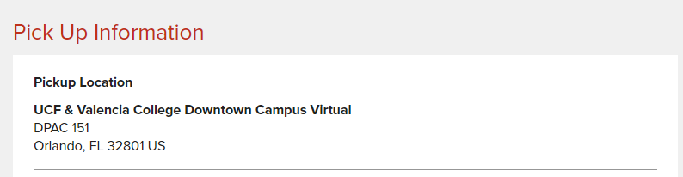
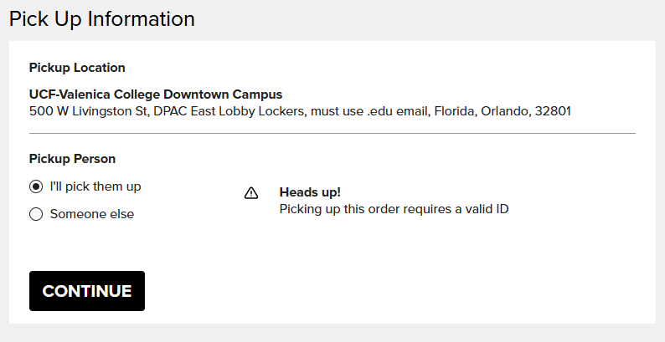
Step 7
Please select in-store pick up/Locker Pickup:
  UCF-Valencia Campus DPAC 151 (Available first 3 weeks of the semester only)
  UCF-VALENCIA COLLEGE DOWNTOWN CAMPUS EAST Lobby lockers (must use your valencia student email or you will not receive locker pickup email with code to retrieve your order)
SHIPPING is not FREE we recommend all de students select in-store pick up.
OR
NOTE: FREE UPS GROUND WILL ARRIVE IN 1-2 BUSINESS DAYS
ANYWHERE IN FLORIDA, do not SELECT 2ND DAY OR NEXT DAY AIR

Slide 9
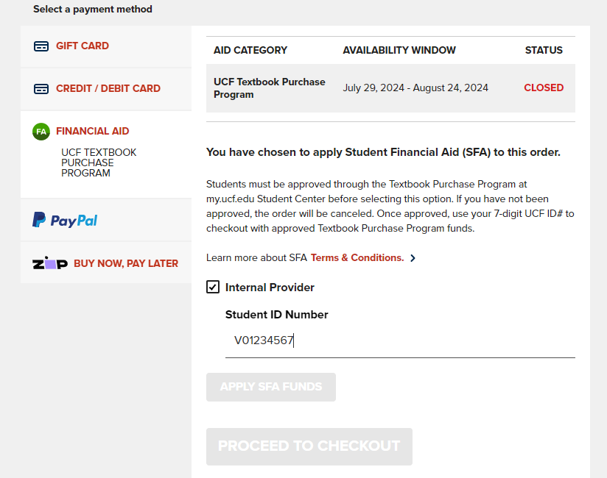
Step 8
PAYMENT SCREEN - CLICK FINANCIAL AID, THEN CHECK THE INTERNAL PROVIDER BOX
ENTER STUDENT NAME, AND VALENCIA ID V######## (including the V)

Slide 10
STEP 9
COMPLETE YOUR ORDER
YOU WILL RECEIVE AN ORDER CONFIRMATION EMAIL AND THEN A SEPARATE EMAIL WHEN THE ORDER IS READY FOR PICK UP/PLACED IN LOCKER FOR PICK UP. (ORDER CONFIRMATION IS NOT LOCKER PICK UP CONFIRMATION- THERE WILL BE A SEPARATE EMAIL FROM THE LOCKER COMPANY WITH INSTRUCTIONS AND LOCKER INFORMATION)

Slide 11
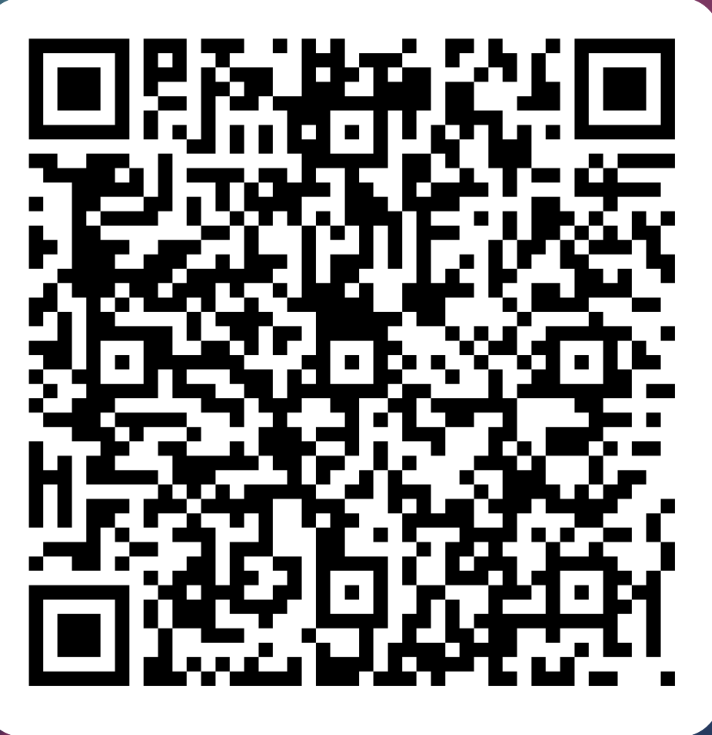
CONTACT US
Please email textbooksonline@ucf.edu OR YOU CAN call 407-823-3166 or 407-823-3356 with any questions during the ordering process we are here and happy to help.
Submit inquiry via qr code below and receive a response within 24-48 hrs.

