Slide 1

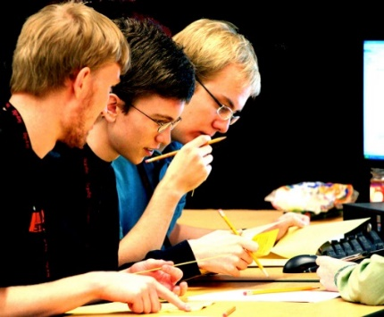




MAT 0022C/0028C Final Exam Review
BY:
West Campus Math Center

Slide 2
Topics
Factoring
  #1, 2, 3, 4, 5, 6, 7, 8, 9, 10, 11, 12, 13, 14, 15, 16, 17, 18
Problem Solving (Word Problems)
  #19, 20, 21, 22, 23, 24, 25, 26, 27, 66, 67, 68, 69, 70
Graphing
  #28, 29, 30, 31, 32, 33, 34, 35
Exponents and Polynomials
  #36, 37, 38, 39, 40, 41, 42, 43, 44, 45
Square Roots/Radicals
  #46, 47, 48, 49, 50, 51, 68
Equations and Inequalities
  #52, 53, 54, 55, 56, 57, 58, 59, 60, 61, 62, 63, 64, 65,
Test Taking Tips
  MyMathLab Tips, How to study, General Test Taking Tips

Slide 3

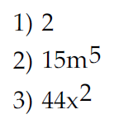
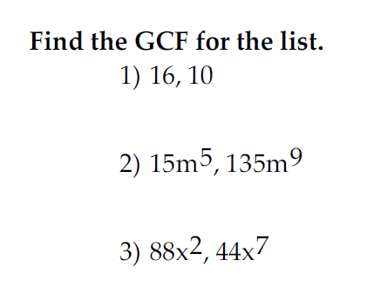
Problem #1, 2, 3 (GCF)
1) GCF = 2
2) GCF = 15m⁵
3) GCF = 44x²
Remember GCF for like variables = smallest exponent
EXAMPLE: GCF for x⁵, x³ = x³ (pick smallest exponent)

Slide 4
Factoring Trinomials
(Leading Coefficient = 1)
Form: x² + bx + c
Signs could be + or – in the trinomial.
Form: x² + bx + c
Factored Form: (x )(x )
+c
-c
Sign of
Bigger Factor
Matches
Middle
Term
bx
}
+
–
+
+
Match Sign of
Middle Term
bx
–
–

Slide 5
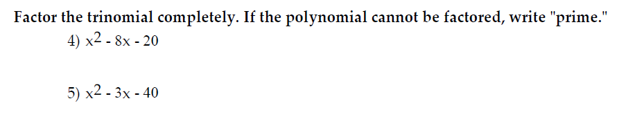
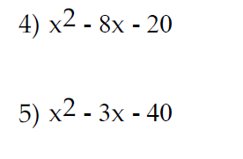

Problem #4 (Factoring Trinomials)
-20
Factored Form: (x )(x )
1
20
Find factors of 20 that
subtract to make 8.
+
2
–
10
4
5
Sign of bigger factor matches middle term
bx
Solution: (x + 2)(x – 10)

Slide 6

Problem #5 (Factoring Trinomials)
-40
Factored Form: (x )(x )
1
40
Find factors of 40 that
subtract to make 3.
2
20
4
10
Sign of bigger factor matches middle term
bx
+
5
–
8
Solution: (x + 5)(x – 8)

Slide 7
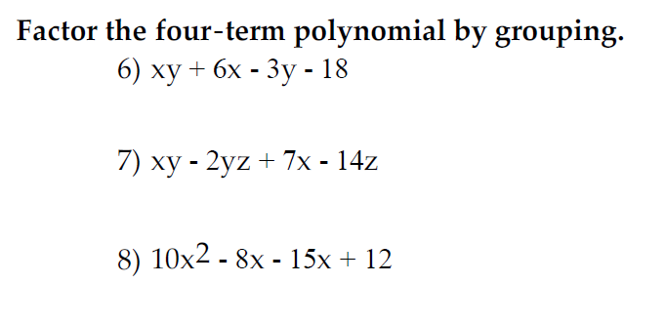

Problem #6 (Factoring)
xy + 6x – 3y – 18
GCF = x
x(y + 6)
GCF = -3
-3(y + 6)
(y + 6)
(x – 3)
(y + 6)(x – 3)

Slide 8

Problem #7 (Factoring)
xy – 2yz + 7x – 14z
GCF = y
y(x – 2z)
GCF = +7
+7(x – 2z)
(x – 2z)
(y + 7)
(x – 2z)(y + 7)

Slide 9


Problem #8 (Factoring)
10x² – 8x – 15x + 12
GCF = 2x
2x(5x – 4)
GCF = –3
–3(5x – 4)
(5x – 4)
(2x – 3)
Live
example!
(5x – 4)(2x – 3)

Slide 10
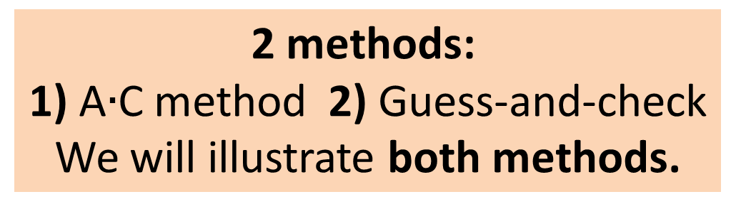
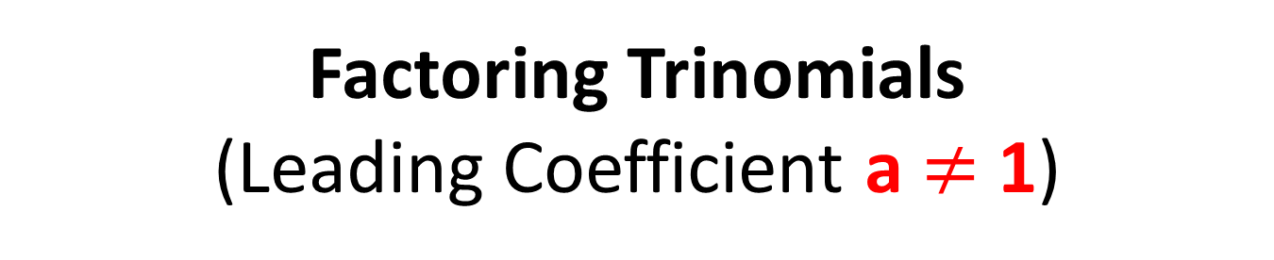
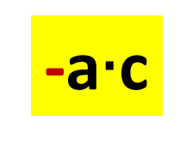

Factoring Trinomials
(Leading Coefficient a $≠$ 1)
Form: ax² + bx + c
Signs could be + or – in the trinomial.
2 methods:
1) A$∙$C method 2) Guess-and-check
We will illustrate both methods.
+a$∙$c
-a$∙$c
Sign of
Bigger Factor
Matches
Middle
Term
bx
}
+
–
+
+
Match Sign of
Middle Term
bx
–
–

Slide 11
SIGN RULES
(For all Factoring Methods)
+
–
Sign of
Bigger Factor
Matches
Middle
Term
bx
}
+
+
Match Sign of
Middle Term
bx
+
–
–
–

Slide 12
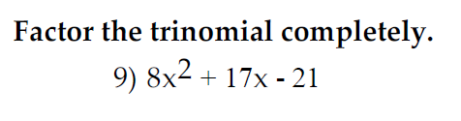
Problem #9 (Factoring – AC method)
-168
Find factors of 168 that
subtract to make 17.
1
168
8
21
2
81
12
14
Sign of bigger factor matches middle term
bx
3
56
4
42
4 terms: 8x² + 24x – 7x – 21
6
28
We now factor by grouping!
–
7
+
24

Slide 13

Problem #9 CONT…
-168
4 terms: 8x² + 24x – 7x – 21
–7
+24
8x² + 24x – 7x – 21
GCF = 8x
8x(x + 3)
GCF = – 7
– 7(x + 3)
(x + 3)
(8x – 7)
(x + 3)(8x – 7)

Slide 14


Problem #10
(Factoring – Guess/check method)
–
(4y 3)(4y 3)
–
(4y – 3)²
1y
16y
1
9
2y
8y
–
3
–
3
SAME SIGNS,
Match Middle Term!
4y
4y

Slide 15

Problem #11 (Factoring – AC method)
-144
Find factors of 144 that
subtract to make 7.
1
144
+
9
–
16
2
72
12
12
Sign of bigger factor matches middle term
bx
3
48
4
38
4 terms: 12x² + 9x – 16x – 12
6
24
We now factor by grouping!
Live
example!
8
18

Slide 16

Problem #11 CONT…
-144
4 terms: 12x² + 9x – 16x – 12
+9
–16
12x² + 9x – 16x – 12
GCF = 3x
3x(4x + 3)
GCF = – 4
– 4(4x + 3)
Live
example!
(4x + 3)
(3x – 4)
(4x + 3)(3x – 4)

Slide 17


Problem #12 (Factoring)
+36
Factored Form: (x )(x )
1
36
Find factors of 36 that
add to make 12.
2
18
3
12
SAME SIGNS, Match Middle Term!
4
9
Solution: (x + 6)(x + 6) = (x + 6)²
+
6
+
6

Slide 18


Problem #13 (Factoring)
–
(6x 5)(6x 5)
–
(6x – 5)²
1x
36x
1
25
2x
18x
–
5
–
5
3x
12x
SAME SIGNS,
Match Middle Term!
4x
9x
6x
6x

Slide 19
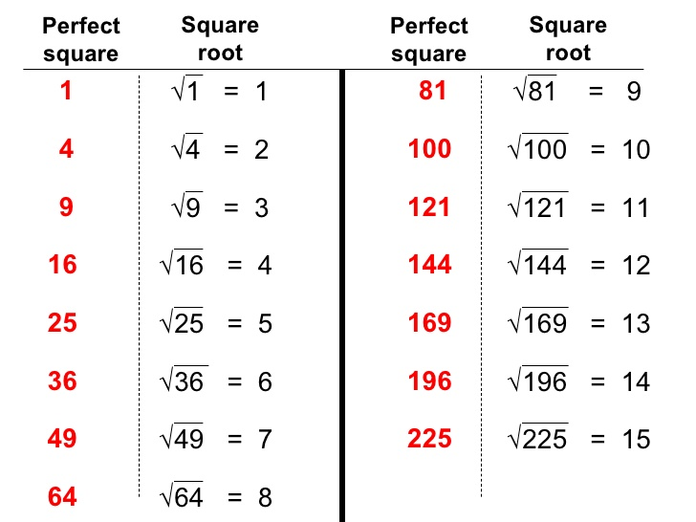
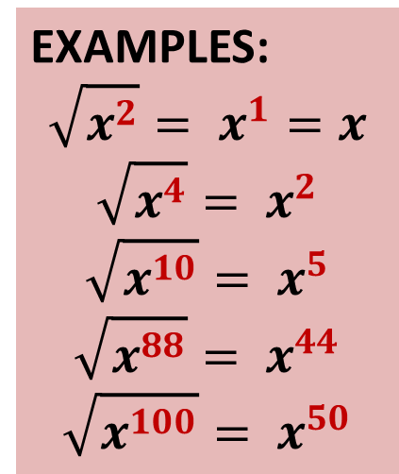
Factoring Difference of Squares
Form: a² – b²
Factored Form: (a + b)(a – b)
where a and b are square roots.
For variable,
divide exponent by 2
EXAMPLES:
$$\sqrt{x^{2}}= x^{1}=x$$
$$\sqrt{x^{4}}= x^{2}$$
$$\sqrt{x^{10}}= x^{5}$$
$$\sqrt{x^{88}}= x^{44}$$
$$\sqrt{x^{100}}= x^{50}$$

Slide 20
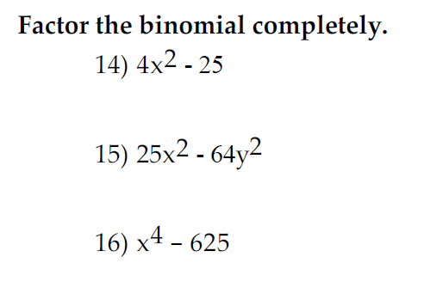

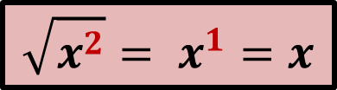
Problem #14 (Difference of Squares)
Factored Form: ( + )( – )
Solution: (2x + 5)(2x – 5)
$$\sqrt{x^{2}}= x^{1}=x$$
4x²
25
2x
2x
5
5

Slide 21

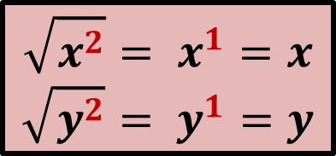
Problem #15 (Difference of Squares)
Factored Form: ( + )( – )
$$\sqrt{x^{2}}= x^{1}=x$$
$$\sqrt{y^{2}}= y^{1}=y$$
Solution: (5x + 8y)(5x – 8y)
25x²
64y²
5x
5x
8y
8y

Slide 22


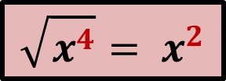
Problem #16 (Difference of Squares)
$$\sqrt{625}=25$$
$$\sqrt{x^{4}}= x^{2}$$
Factored Form: ( + )( – )
x⁴
625
Solution: (x² + 25)(x² – 25)
x²
x²
25
25
x
x
5
5
Solution: (x² + 25)(x – 5)(x + 5)
Live
example!

Slide 23
Factoring ONLY vs. Solving
Factor:
x² + 6x + 8
Solve:
x² + 6x + 8 = 0
(x )(x )
(x + 2)(x + 4) = 0
Find factors of 8 that
add to make 6.
+8
Same Signs,
Match Middle
(x + 2) = 0
(x + 4) = 0
1
8
+
2
+
4
x = –2
x = –4
(x + 2)(x + 4)

Slide 24
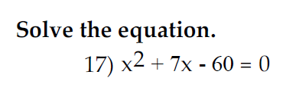
Problem #17 (Factoring)
-60
1
60
Factored Form: (x )(x ) = 0
2
30
Find factors of 60 that
subtract to make 7.
3
20
4
15
Sign of bigger factor matches middle term
bx
–
5
+
12
Factored: (x – 5)(x + 12) = 0
6
10

Slide 25

Problem #17 CONT…
Factored: (x – 5)(x + 12) = 0
(x – 5) = 0
(x + 12) = 0
x = 5
x = –12

Slide 26
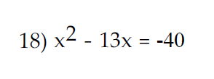
Problem #18 (Factoring)
First Step, make
equation equal to 0
ADD 40 to both sides!
Solve: x² – 13x + 40 = 0
+40
Factored Form: (x )(x ) = 0
1
40
Find factors of 40 that
add to make 13.
2
20
4
10
Same Signs, Match Middle
–
5
–
8
Factored: (x – 5)(x – 8) = 0

Slide 27

Problem #18 CONT…
Solve: x² – 13x + 40 = 0
Factored: (x – 5)(x – 8) = 0
(x – 5) = 0
(x – 8) = 0
Live
example!
x = 5
x = 8

Slide 28
Problem Solving (Types)
Percent and Applications
Proportions
Perimeter (Rectangle)
Pythagorean Theorem (a² + b² = c²)

Slide 29
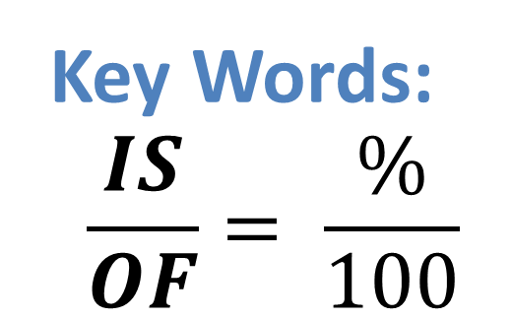
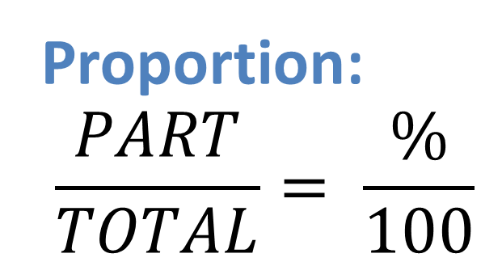
Percent Applications (2 methods)
Proportion:
$$\frac{PART}{TOTAL}= \frac{\%}{100}$$
Equation:
Key Words:
IS: =
OF: Multiply
Key Words:
$$\frac{IS}{OF}= \frac{\%}{100}$$
What number/percent
→ Variable
What number/percent
→ Variable

Slide 30
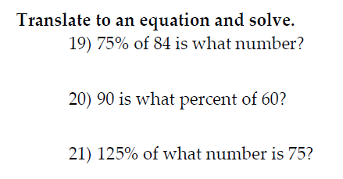

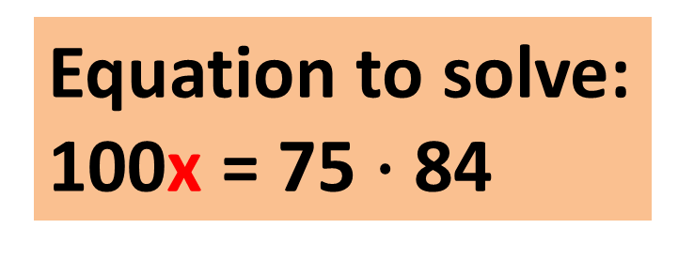

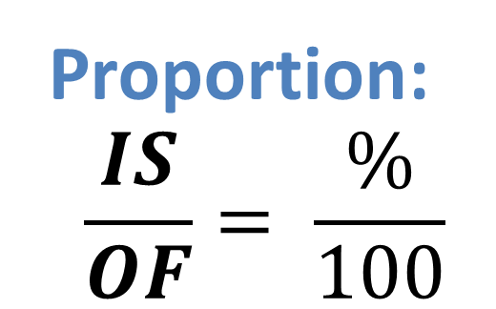
Problem #19 (Problem Solving)
Proportion:
$$\frac{IS}{OF}= \frac{\%}{100}$$
75% of 84 is what number?
Solve:
$$\frac{x}{84}= \frac{75}{100}$$
Equation to solve:
100x = 75 $∙$ 84
100x = 6300
x = 63

Slide 31
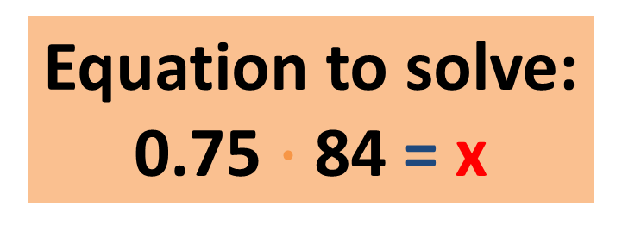
Problem #19 (Method #2)
75% of 84 is what number?
Equation to solve:
0.75 $∙$ 84 = x
Change 75% → 0.75
x = 63

Slide 32

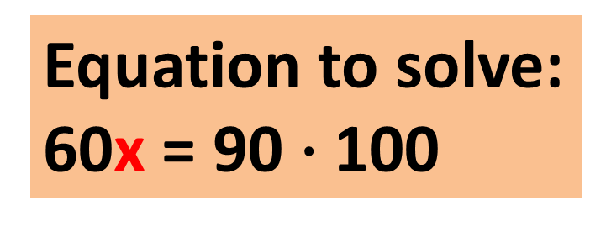

Problem #20 (Problem Solving)
Proportion:
$$\frac{IS}{OF}= \frac{\%}{100}$$
90 is what percent of 60?
Solve:
$$\frac{90}{60}= \frac{x}{100}$$
Equation to solve:
60x = 90 $∙$ 100
60x = 9000
x = 150%

Slide 33
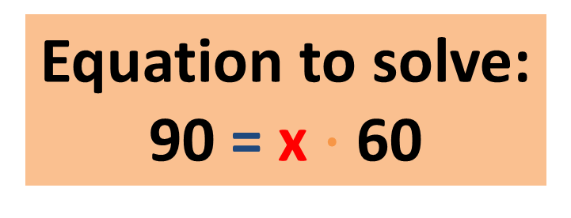
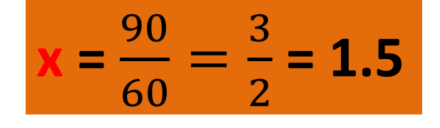
Problem #20 (Method #2)
90 is what percent of 60?
Equation to solve:
90 = x $∙$ 60
x = $\frac{90}{60}=\frac{3}{2}$ = 1.5
Change 1.5 → 150%

Slide 34

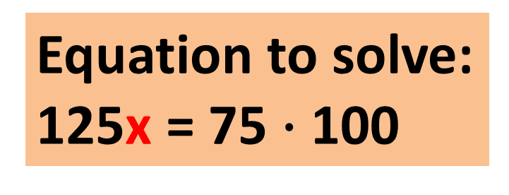
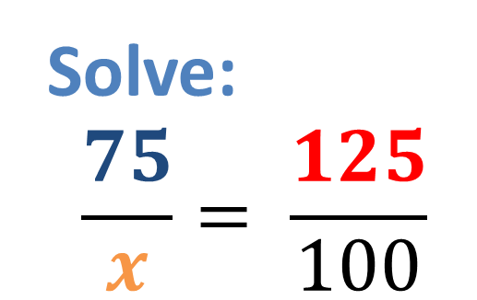
Problem #21 (Problem Solving)
Proportion:
$$\frac{IS}{OF}= \frac{\%}{100}$$
125% of what number is 75?
Solve:
$$\frac{75}{x}= \frac{125}{100}$$
Equation to solve:
125x = 75 $∙$ 100
125x = 7500
x = 60

Slide 35
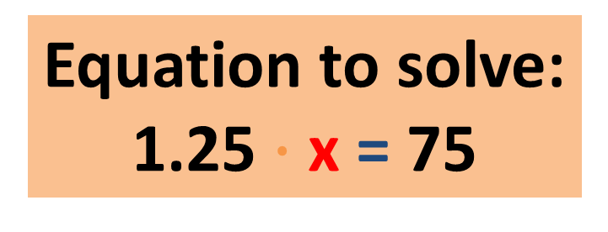
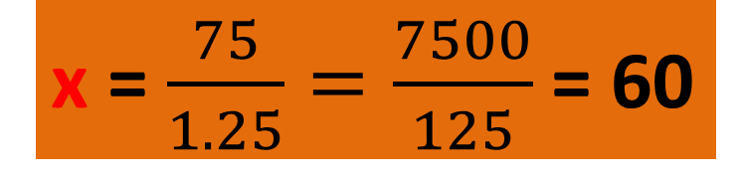
Problem #21 (Method #2)
125% of what number is 75?
Change 125% → 1.25
Equation to solve:
1.25 $∙$ x = 75
x = $\frac{75}{1.25}=\frac{7500}{125}$ = 60
Live
example!

Slide 36


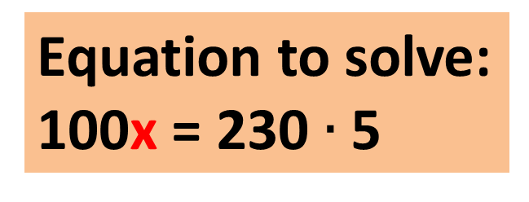

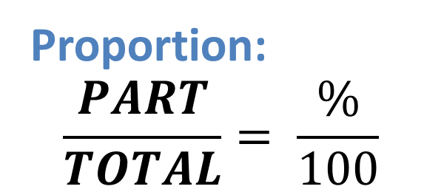
Problem #22 (Problem Solving)
Proportion:
$$\frac{PART}{TOTAL}= \frac{\%}{100}$$
Total = $230; Percent = 5%
Part is missing (Discount Amount)
Equation to solve:
100x = 230 $∙$ 5
Solve:
$$\frac{x}{230}=\frac{5}{100}$$
100x = 1150
x = $11.50 (Discount)
Sales Price = $230 - $11.50 = $218.50

Slide 37
Problem #22 (Alternative Method)
Total = $230
Percent = 5%
Discount = 5% of 120,000
of: key word for multiply!
Solve: (0.05)(230)
= $11.50 (Discount)
Sales Price = $230 - $11.50 = $218.50

Slide 38

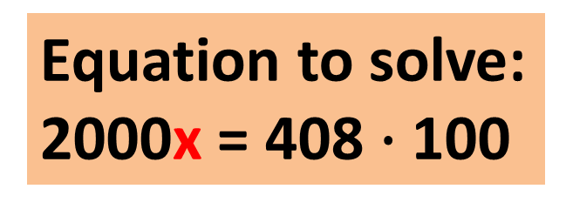

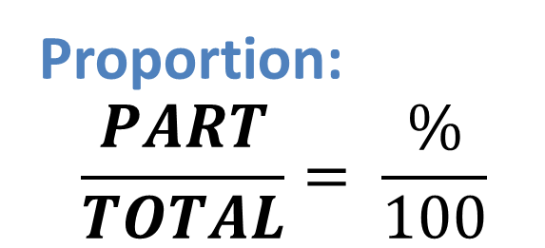
Problem #23 (Problem Solving)
Proportion:
$$\frac{PART}{TOTAL}= \frac{\%}{100}$$
Total = $2000; Part = $408
Percent is missing
Equation to solve:
2000x = 408 $∙$ 100
Solve:
$$\frac{408}{2000}=\frac{x}{100}$$
2000x = 40800
x = 20.4%

Slide 39
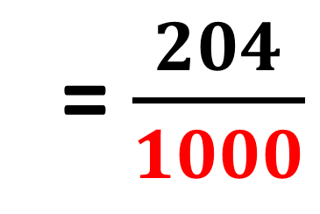
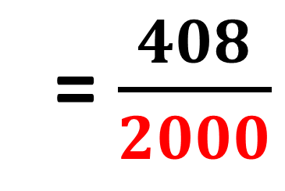

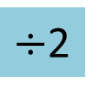

Problem #23 (Alternative Method)
$$\frac{PART}{TOTAL}$$
= $\frac{408}{2000}$
= $\frac{204}{1000}$
$÷$2
= 0.204
$÷$2
= 20.4%
Live
example!

Slide 40
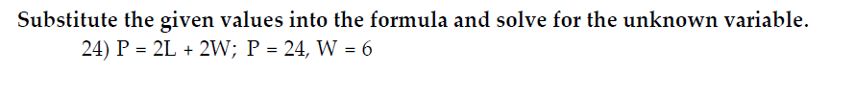
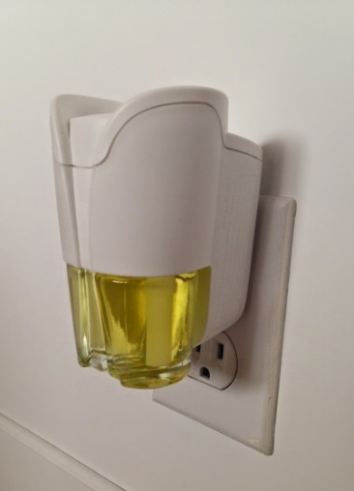

Problem #24 (Problem Solving)
Just Plug-in:
P = 24, W = 6
P = 2L + 2W; P = 24, W = 6
Live
example!
Solve:
2L + 12 = 24
24 = 2L + 2(6)
24 = 2L + 12
L = 6

Slide 41
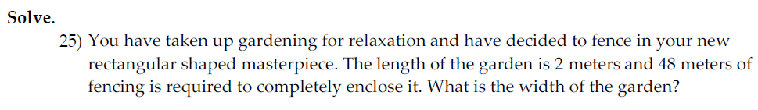
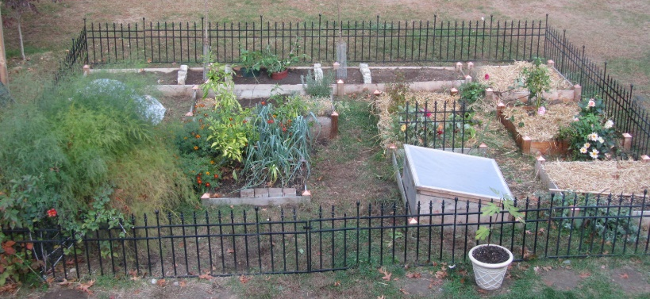

Problem #25 (Problem Solving)
2 m
Fencing goes around (Perimeter)
w
= 48 m
w
2 m
Solve: 2w + 4 = 48
w = 22 m

Slide 42
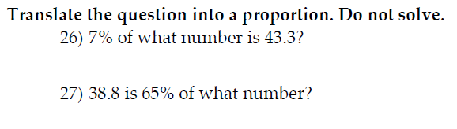
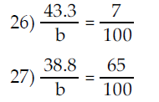
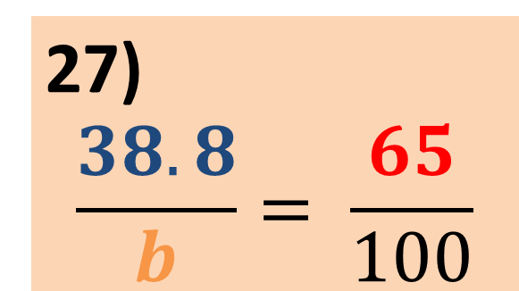
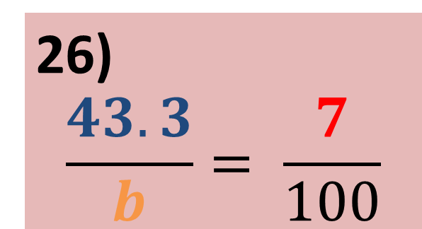

Problem #26, 27 (Problem Solving)
Proportion:
$$\frac{IS}{OF}= \frac{\%}{100}$$
26) 7% of what number is 43.3?
27) 38.8 is 65% of what number?
26)
$$\frac{43.3}{b}= \frac{7}{100}$$
27)
$$\frac{38.8}{b}= \frac{65}{100}$$

Slide 43


Problem #28 (Graphing)
x | y
(0, | __)
(__, | 0)
-2
(-2, 0)
-2
(0, -2)

Slide 44

Solution for #28

Slide 45




Problem #29 (Graphing)
x-intercept (Plug y = 0):
16(0) – 4x = –8
y-intercept (Plug x = 0):
16y – 4(0) = –8
Solve:
– 4x = –8;
x = 2
Solve
16y = –8;
y = $−\frac{8}{16}=−\frac{1}{2}$
x | y
(__, | 0)
(0, | __)
2
x-int:
(2, 0)
y-int:
(0, $−\frac{1}{2}$)
$$−\frac{1}{2}$$

Slide 46

Problem #29 (Graphing)
x | y
(__, | 0)
(0, | __)
2
$$−\frac{1}{2}$$
(2, 0)
(0, - ½)

Slide 47

Solution for #29
Live
example!

Slide 48



Problem #30 (Graphing)
Slope-intercept form:
y = mx + b
y = $\frac{2}{5}x$ – 1
First point: (0, -1)
(5, 1)
Slope = $\frac{2}{5}= \frac{UP 2}{RIGHT 5}$
(0, - 1)

Slide 49


Problem #30 (Alternative Method)
For x = 0:
y = $\frac{2}{5}$(0) – 1
x | y
( , | )
( , | )
y = –1
0
-1
For x = 5:
y = $\frac{2}{5}$(5) – 1
5
1
y = 1

Slide 50
Problem #30 CONT…
x | y
( , | )
( , | )
0
-1
5
1
(5, 1)
(0, - 1)

Slide 51

Solution for #30
Live
example!

Slide 52


Problem # 31 (Slope)
1) Remember slope-intercept form; y = mx + b
2) The slope is the coefficient of x; m.
Number in front of x is the slope.
The slope for y = -8x – 10 is -8.
m = - 8 (SLOPE)

Slide 53






Problem #32 (Slope)
y₁
x₂
y₂
Slope between 2 points
x₁
m = $\frac{y_{2} − y_{1}}{x_{2} − x_{1}}$
7
–5
= $\frac{7 + 5 }{ 8 + 9 }$
= $\frac{12 }{ 17 }$
m = $\frac{ − }{ − }$
8
–9

Slide 54

Problem #32 (Checking)
Right 17
(8, 7)
Up 12
= positive
slope
(-9, - 5)

Slide 55





Problem #33 (Graphing)
Any method is acceptable
since no method is specified.
After Solving, we have:
y = $\frac{1}{2}x − \frac{7}{2}$ →
y = $\frac{1}{2}x −3\frac{1}{2}$
Slope-intercept form:
y = mx + b
Solve for y.
Slope-intercept form:
y = mx + b
y = $\frac{1}{2}x$ – 3$\frac{1}{2}$
First point: (0, – 3$\frac{1}{2}$)
Slope = $\frac{1}{2}= \frac{UP 1}{RIGHT 2}$

Slide 56



Problem #33 CONT…
Slope-intercept form:
y = mx + b
y = $\frac{1}{2}x$ – 3$\frac{1}{2}$
First point: (0, – 3$\frac{1}{2}$)
Slope = $\frac{1}{2}= \frac{UP 1}{RIGHT 2}$
(2, -2½)
(0, - 3½)

Slide 57




Problem #33 (Alternative Method)
We must still solve for y:
y = $\frac{1}{2}x −3\frac{1}{2}$
For x = 0:
y = $\frac{1}{2}$(0) – 3 $\frac{1}{2}$
x | y
( , | )
( , | )
y = –3$\frac{1}{2}$
0
-3½
For x = 2:
y = $\frac{1}{2}$(2) – 3 $\frac{1}{2}$
2
-2½
y = -2½

Slide 58
Problem #33 CONT…
x | y
( , | )
( , | )
0
-3½
2
-2½
(2, -2½)
(0, - 3½)

Slide 59

Solution for #33

Slide 60
Problem #34 (Graphing)
x | y
(0, | __)
(__, | 0)
-5
(-5, 0)
-5
(0, -5)

Slide 61

Solution for #34

Slide 62


Problem #35 (Intercepts)
x-intercept (Plug y = 0):
4x + 5(0) = 20
y-intercept (Plug x = 0):
4(0) + 5y = 20
Solve:
4x = 20;
x = 5
Solve:
5y = 20;
y = 4
x | y
(__, | 0)
(0, | __)
5
x-int:
(5, 0)
y-int:
(0, 4)
4

Slide 63


Problem #36 (Exponents)
1) Remember property: x^{m}x^{n} = x^{m + n}
EXAMPLE: x⁵x² = x⁷
(For multiplication → ADD exponents for like variables)
2) For coefficients, multiply!
(-3m²z⁴)(2m²z²) = -6m⁴z⁶

Slide 64


Problem #37, 38 (Simplifying)
6m² + 10m – 17m² + 5m
= -11m² + 15m
9x⁵ + 4x⁴ – 3x⁵
= 6x⁵ + 4x⁴
6

Slide 65


Problem #39 (Polynomials)
Descending Order: Highest → Lowest Exponent
Number/Constant is always last!
Concept: Combining Like Terms
9x + 6 – 11x + 4
= –2x + 10

Slide 66


Problem #40 (Polynomials)
Just copy
Multiply by -1 (change signs)
4x⁷ – 8x⁶ – 5
– 2x⁷ – 11x⁶ – 19
2x⁷
–19x⁶
–24

Slide 67


Problem #41 (Exponents)
1) Remember property: (x^{m})^{n} = x^{mn}
EXAMPLE: (x⁵)² = x¹⁰
(For exponents to exponents → MULITPLY exponents for like variables)
2) For coefficients, raise to exponent like usual!
(-3x¹y⁴)⁴
=(-3)⁴ x⁴y¹⁶
= 81x⁴y¹⁶
Check: (-3xy⁴)(-3xy⁴)(-3xy⁴)(-3xy⁴) = 81x⁴y¹⁶

Slide 68


Problem #42 (Polynomials)
(4x + 4)(x – 3)
4x² – 12x
+4x – 12
4x² – 8x – 12

Slide 69


Problem #43 (Polynomials)
Write the binomial twice!
(3a – 4)(3a – 4)
9a² – 12a
–12a + 16
9a² – 24a + 16

Slide 70


Problem #44 (Exponents)
1) Remember property: (x^{m})^{n} = x^{mn}
EXAMPLE: (x⁵)² = x¹⁰
(For exponents to exponents → MULITPLY exponents for like variables)
2) For coefficients, raise to exponent like usual!
(-3a⁶b⁴)³
=(-3)³ a¹⁸b¹²
= –27a¹⁸b¹²
Check: (-3a⁶b⁴)(-3a⁶b⁴)(-3a⁶b⁴) = –27a¹⁸b¹²

Slide 71


Problem #45 (Polynomials)
Write the binomial twice!
(3m + 1)(3m + 1)
9m² + 3m
+ 3m + 1
9m² + 6m + 1

Slide 72
Simplifying Square Roots
Know your perfect squares!
We will factor our biggest perfect square!
For variable,
divide exponent by 2
EXAMPLES:
$$\sqrt{x^{2}}= x^{1}=x$$
$$\sqrt{x^{4}}= x^{2}$$
$$\sqrt{x^{10}}= x^{5}$$
$$\sqrt{x^{88}}= x^{44}$$
$$\sqrt{x^{100}}= x^{50}$$

Slide 73






Problem #46 (Square Roots/Radicals)
$$\sqrt{x^{2}}=x$$
$$\sqrt{16x^{2}} ∙\sqrt{3y}$$
4x
$$\sqrt{3y}$$
4x $\sqrt{3y}$

Slide 74






Problem #47 (Square Roots/Radicals)
$$\sqrt{x^{2}}=x$$
$$\sqrt{36x^{2}} ∙\sqrt{3}$$
6x
$$\sqrt{3}$$
6x $\sqrt{3}$

Slide 75






Problem #48 (Square Roots/Radicals)
$$\sqrt{x^{12}}= x^{6}$$
$$\sqrt{49x^{12}} ∙\sqrt{x}$$
7x⁶
$$\sqrt{x}$$
7x⁶ $\sqrt{x}$
Live
example!

Slide 76









Problem #49 (Square Roots/Radicals)
4y² $\sqrt{2y}$
= $\frac{\sqrt{32y^{5}}}{\sqrt{49x^{8}}}$
=7x⁴
$$\sqrt{32y^{5}}$$
$$\sqrt{y^{4}}= y^{2}$$
$$\sqrt{16y^{4}} ∙\sqrt{2y}$$
$$\frac{4y^{2}\sqrt{2y}}{7x^{4}}$$
4y²
$$\sqrt{2y}$$

Slide 77









Problem #50 (Square Roots/Radicals)
$$\sqrt{20}$$
4$\sqrt{5}$ – 7(2 $\sqrt{5}$)
$$\sqrt{4} ∙\sqrt{5}$$
2
$$\sqrt{5}$$
4$\sqrt{5}$ – 14$\sqrt{5}$
2 $\sqrt{5}$
–10$\sqrt{5}$

Slide 78
















Problem #51
(Square Roots/Radicals)
$$\sqrt{48}$$
$$\sqrt{243}$$
4 $\sqrt{3}$
–10($9\sqrt{3}$)
–9($2\sqrt{3}$)
$$\sqrt{16} ∙\sqrt{3}$$
$$\sqrt{81} ∙\sqrt{3}$$
4$\sqrt{3}\text{–}\text{9}\text{0}\sqrt{3}$ $\text{–}\text{18}\sqrt{3}$
4
$$\sqrt{3}$$
9
$$\sqrt{3}$$
$$\sqrt{12}$$
$$\text{–}\text{104}\sqrt{3}$$
$$\sqrt{4} ∙\sqrt{3}$$
Live
example!
2
$$\sqrt{3}$$

Slide 79



Problem #52 (Equations)
A = P + PRT
–P
–P
A – P = PRT
T = $\frac{A −P}{PR}$
PR
PR

Slide 80






Problem #53 (Equations)
Clear fractions!
V = $\frac{1}{3}$Ah
$$∙3$$
$$∙3$$
h = $\frac{3V}{A}$
3V = Ah
A
A

Slide 81


Problem #54 (Equations)
-1x = 11
-1
-1
3x = 4(x + 4) – 5
3x = 4x + 16 – 5
x = -11
3x = 4x + 11
–4x
–4x

Slide 82


Problem #55 (Equations)
-4x = 24
-4
-4
-4(x + 3) – 36 = –14 – 10
x = -6
-4x – 12 – 36 = – 24
-4x – 48 = – 24
+48
+48

Slide 83











Problem #56 (Equations)
Clear fractions!
LCD = 10
$$2$$
$$5$$
$$2$$
$$\frac{6}{5}x=−\frac{1}{2} − \frac{3}{5}$$
$$∙10$$
$$∙10$$
$$∙10$$
x = $−\frac{11}{12}$
2 $∙$ 6x = 5 $∙$ –1 – 2$∙$ 3
12x = – 5 – 6
12x = – 11
12
12

Slide 84







Problem #57 (Equations)
Clear fractions!
LCD = 3
$$\frac{a}{3} −\frac{1}{3}=−5$$
$$∙3$$
$$∙3$$
$$∙3$$
a – 1 = –15
+1
+1
Live
example!
a = $−$14

Slide 85









Problem #58 (Equations)
Clear fractions!
LCD = 15
$$5$$
$$3$$
$$\frac{5}{3} − \frac{x}{5}= \frac{13}{15}$$
-3x = -12
$$∙15$$
$$∙15$$
$$∙15$$
-3
-3
5 $∙$ 5 – 3x = 13
25 – 3x = 13
x = 4
-25
-25
– 3x = –12

Slide 86



Problem #59 (Equations)
Get variable to 1 side!
7x – 7 = 5x - 8
2x = -1
–5x
–5x
2
2
2x – 7 = –8
x = $−\frac{1}{2}$
+7
+7
2x = –1

Slide 87

Problem #60 (Equations)
Clear Decimals!
Move decimal point 2 places over.
1.4 x – 3.1 = 0.7 x – 1.98
0
0
0
140x – 310 = 70x – 198
–70x
–70x
70x – 310 = – 198
+310
+310
70x = 112

Slide 88








Problem #60 CONT…
70x = 112
70
70
$$\frac{112}{70}$$
$$=\frac{56}{35}$$
$÷$2
$$÷7$$
$$=\frac{8}{5}$$
DIVIDE!
$÷$2
$$÷7$$
x = 1.6

Slide 89


Problem #61 (Equations)
Clear Decimals!
Move decimal point 2 places over.
0
-0.7 x + 1.15 = -0.4 x + 2.05
0
-70x + 115 = -40x + 205
-30x = 90
+40x
+40x
-30
-30
-30x + 115 = 205
x = -3
–115
–115
Live
example!
-30x = 90

Slide 90
Graphing Inequalities
For < or >:
( )
For < or >:
[ ]

Slide 91
Interval Notation
For < or >:
Use ( )
For < or >:
Use [ ]
For $−∞$ or $∞$:
Use ( )
ONLY!

Slide 92








Problem #62 (Inequalities)
Inequality Flips/Reverses
When both sides are multiplied/divided by a negative!
$−\frac{1}{5}x$ < 6
$$∙−5$$
$$∙−5$$
Interval Notation:
(-30, $∞$)
$x$ > -30
(
-$∞$
$$∞$$
-30

Slide 93

Problem #63 (Inequalities)
4x < 16
24x + 28 < 4(5x + 11)
4
4
24x + 28 < 20x + 44
–20x
–20x
4x + 28 < 44
Since both sides are being divided by a positive 4,
WE DO NOT FLIP INEQUALITY SYMBOL!
–28
–28
x < 4
4x < 16

Slide 94


Problem #63 CONT…
x < 4
Live
example!
Interval Notation:
($−∞$, 4]
]
-$∞$
$$∞$$
4

Slide 95

Problem #64 (Inequalities)
5y < 45
-5(6y + 3) < -35y + 30
5
5
-30y – 15 < -35y + 30
+35y
+35y
5y – 15 < 30
Since both sides are being divided by a positive 5,
WE DO NOT FLIP INEQUALITY SYMBOL!
+15
+15
y < 9
5y < 45

Slide 96

Problem #64 CONT…
y < 9
Live
example!
Set-builder Notation:
{y| y < 9}
-$∞$
$$∞$$
9

Slide 97





Problem #65 (Inequalities)
Since both sides are being multiplied by a positive 5,
WE DO NOT FLIP INEQUALITY SYMBOL!
$$∙5$$
$\frac{1}{5}$y > 6
$$∙5$$
Set-builder Notation:
{y| y > 30}
y > 30
-$∞$
$$∞$$
30

Slide 98
Problem #66 (Problem Solving)
A fence is to be installed around a rectangular field.
The field’s perimeter is 210 feet. The length of the field is 5 feet
more than the width, find the length.
w + 5
w + 5
w
w
w
w = 50 feet
Width
w + 5
Solve:
4w + 10 = 210
50 + 5 = 55 ft
Length

Slide 99
Problem #66 (Alternative Method)
A fence is to be installed around a rectangular field.
The field’s perimeter is 210 feet. The length of the field is 5 feet
more than the width, find the length.
w + 5
P = 2L + 2W
w
SOLVE:
210 = 2(W + 5) + 2W
Solve:
4w + 10 = 210
w = 50 feet
Width
SOLVE:
210 = 2W + 10 + 2W
50 + 5 = 55 ft
Length

Slide 100



Problem #67 (Problem Solving)
A county assesses annual property taxes at a rate of 4% of the
appraised value of the property. A property is appraised for $120,000.
What are the property taxes?
Total = $120,000
Percent = 4%
Part is missing (Taxes)
Proportion:
$$\frac{PART}{TOTAL}= \frac{\%}{100}$$
Equation to solve:
100x = 120000 $∙$ 4
Solve:
$$\frac{x}{120,000}=\frac{4}{100}$$
100x = 480000
x = $4,800
Live
example!

Slide 101
Problem #67 (Alternative Method)
A county assesses annual property taxes at a rate of 4% of the
appraised value of the property. A property is appraised for $120,000.
What are the property taxes?
Total = $120,000
Percent = 4%
Taxes = 4% of 120,000
of: key word for multiply!
Solve: (0.04)(120,000)
= $4,800
Live
example!

Slide 102


Problem #68 (Problem Solving/Square Roots)
Television Sets: What does it mean to refer to a 20-in TV set or a
25-in TV set? Such units refer the diagonal of the screen.
a) A 15-in TV set also has a width of 12 inches. What is its height?
b) A 20-in TV set also has a width of 16 inches. What is its height?
Right Triangle
a² + b² = c²
(Pythagorean Theorem)
Diagonal
Height
Hypotenuse
c
Diagonal of TV =
Hypotenuse of Right Triangle
Width

Slide 103

Problem #68 (Problem Solving/Square Roots) PART A
Television Sets: What does it mean to refer to a 20-in TV set or a
25-in TV set? Such units refer the diagonal of the screen.
a) A 15-in TV set also has a width of 12 inches. What is its height?
Solve: x² + 12² = 15²
x² + 144 = 225
–144
–144
x² = 81
15 in
x
x = $\sqrt{81}$ = 9 in
12 in
Live
example!

Slide 104

Problem #68 (Problem Solving/Square Roots) PART B
Television Sets: What does it mean to refer to a 20-in TV set or a
25-in TV set? Such units refer the diagonal of the screen.
b) A 20-in TV set also has a width of 16 inches. What is its height?
Solve: x² + 16² = 20²
x² + 256 = 400
–256
–256
x² = 144
20 in
x
x = $\sqrt{144}$ = 12 in
16 in

Slide 105

Pythagorean Triples
Common Pythagorean Values:
1) 3, 4, 5
2) 5, 12, 13
3) 8, 15, 17
4) 7, 24, 25
5) 9, 40, 41
Times 3:
1) 9, 12, 15
Times 4:
1) 12, 16, 20
& Their Multiples
Times 10:
2) 50, 120, 130

Slide 106


Problem #69 (Problem Solving)
People drive, on average, 11,400 miles per year. About how many
miles each week is that? Round to the nearest tenth.
NOTE: 1 year = 52 weeks
$$\frac{11,400}{52}$$
= 219.23 $≈$ 219.2 miles
per week
Long divide!

Slide 107








Problem #70 (Problem Solving)
A woman earns $2600 per month and budgets $338 per month for
food. What percent of her monthly income is spent on food?
$$\frac{PART}{TOTAL}$$
= $\frac{338}{2600}$
= $\frac{169}{1300}$
= $\frac{13}{100}$
$÷$2
$$÷13$$
$÷$2
$$÷13$$
= 13%

Slide 108











MyMathLab Tips
Pay careful attention to all instructions!
$$\frac{3}{4}$$
$$0.75$$
$$110$$
$$109.75$$
$$110$$
$$109.8$$
$$3$$
$$(0, 3)$$

Slide 109
MyMathLab Tips CONT…
Pay careful attention to all instructions!
WRONG!!
RIGHT!!
(-6, 1)
(-5, 0)
(-2, -3)
(0, -5)

Slide 110
How to Study…
1) This workshop is a good step towards studying for the final (Review this presentation and video)
2) Work on the practice final exam in MyMathLab with no help, notes, calculators, or any assistance and time yourself.
3) Review the workshop packet and try to do each problem by yourself with no help, notes, calculators, or any assistance.
4) Review your in-class exams, on-line quizzes, and on-line homework.
5) Visit the Math Connections for additional support and resources!
Study a little each day, DO NOT CRAM!!

Slide 111
General Test Taking Tips
1) Preview the exam and do the problems that are easy and you are familiar with.
2) Pace yourself… do not spend too much time on any 1 problem.
3) DO NOT RUSH!
4) Go back and check your answers (if time allows).
5) Follow instructions carefully!
6) Double check your work!
When you submit your exam, review your exam!

Slide 112

Now go study and do well on your final exam!

