Slide 1
Block Quoting
Computer Instructions on How to Block Quote in Microsoft Word 2010.

Slide 2
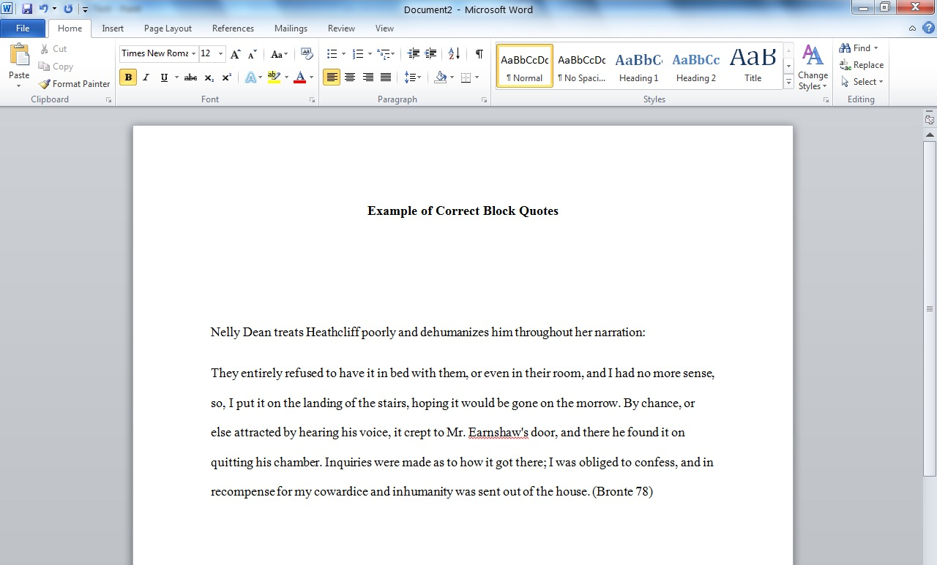
Step 1: Type text that needs to be block quoted.

Slide 3
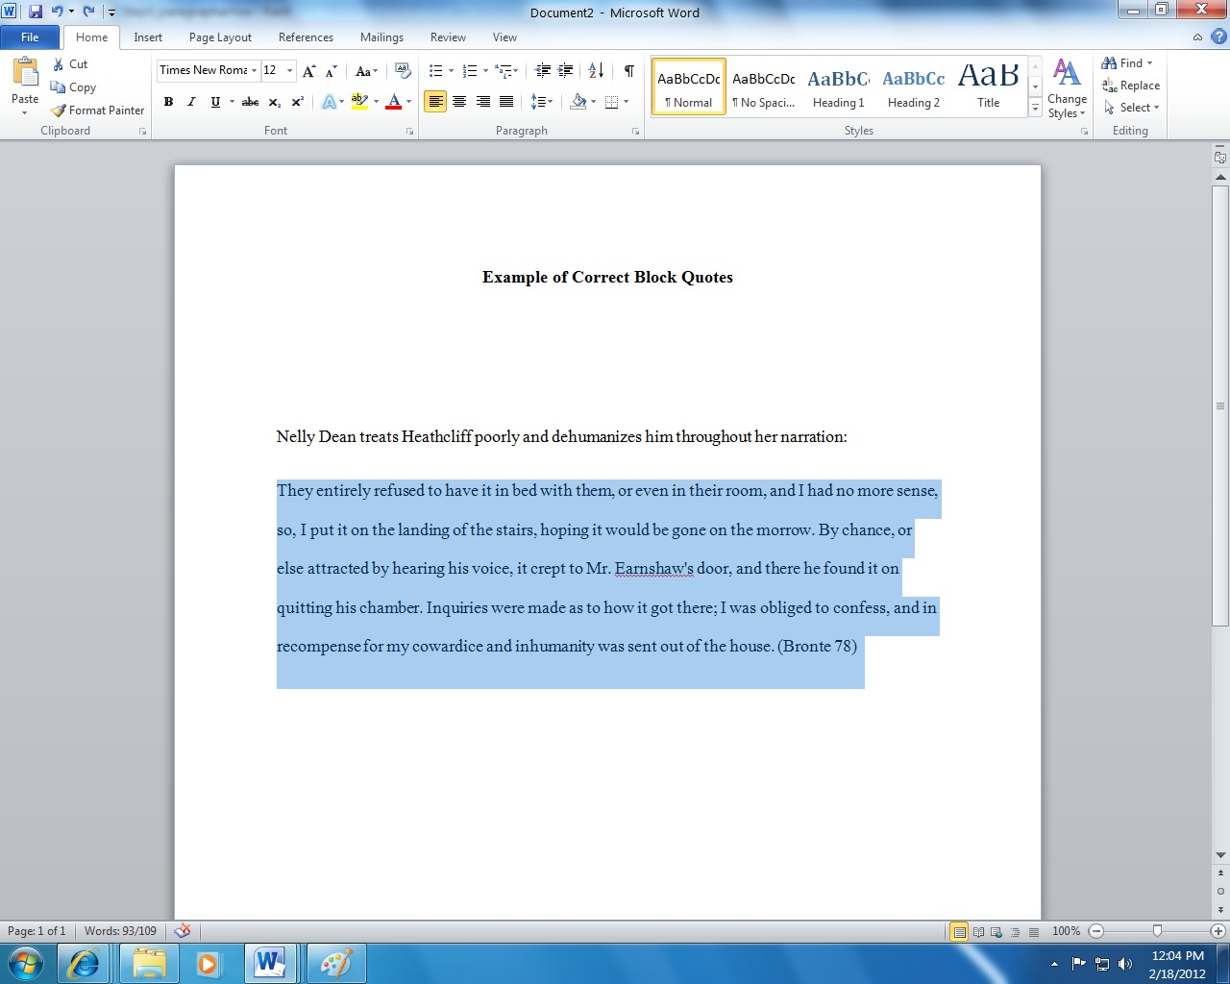
Step 2: Highlight text that needs to be indented.

Slide 4
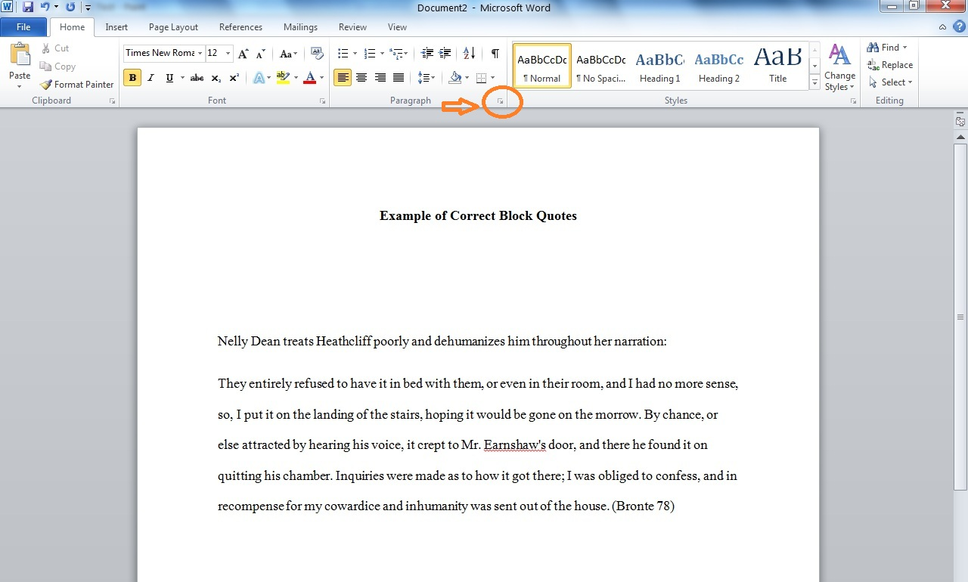
Step 3: Click the arrow in the Paragraph box. Next, an analog box will appear.

Slide 5
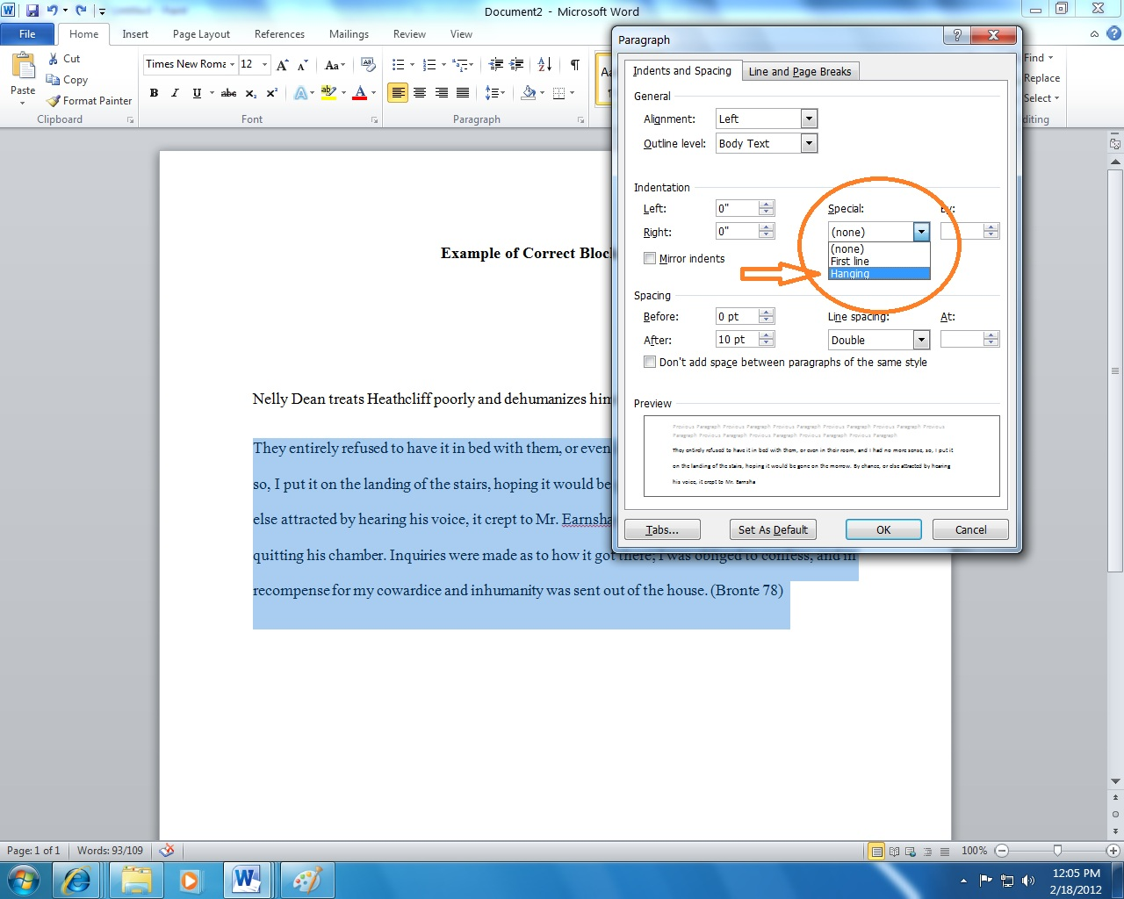
Step 4: Click on the drop down menu in the “Special” box. Select “Hanging” and then Click “Ok”

Slide 6
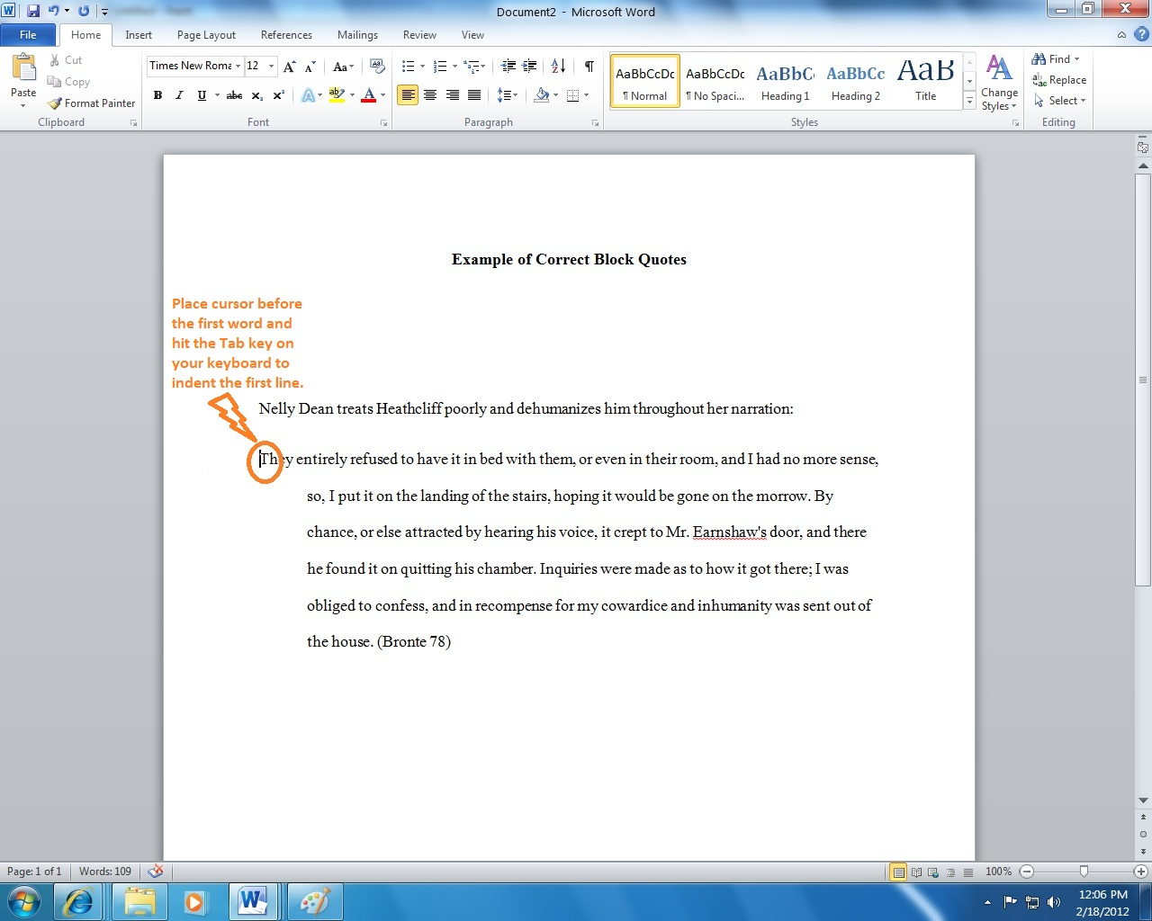
Step 5: Follow instructions in Orange below.

Slide 7
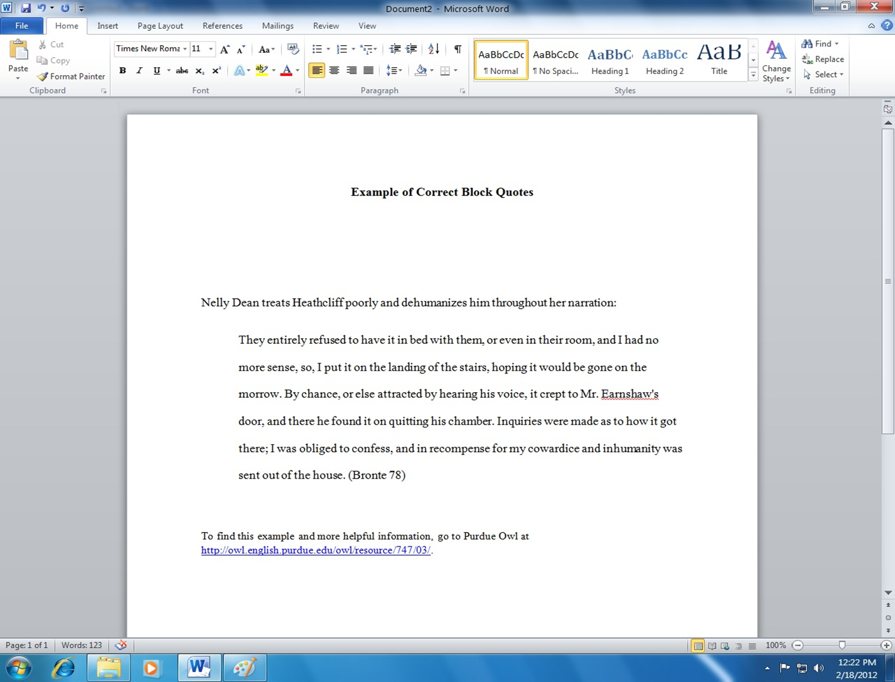
Step 6: This is what your block quote should look like. For more information on block quoting, click on the link in blue below, or ask a CSSC staff member for more information. Note: Block Quote is from Purdue Owl.

